Slide 1
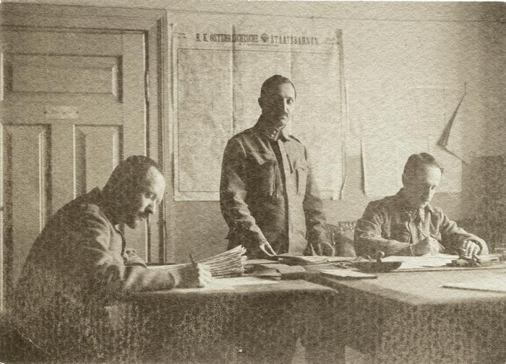
Photographies Don Pawlowicki (p005204)

