Slide 1
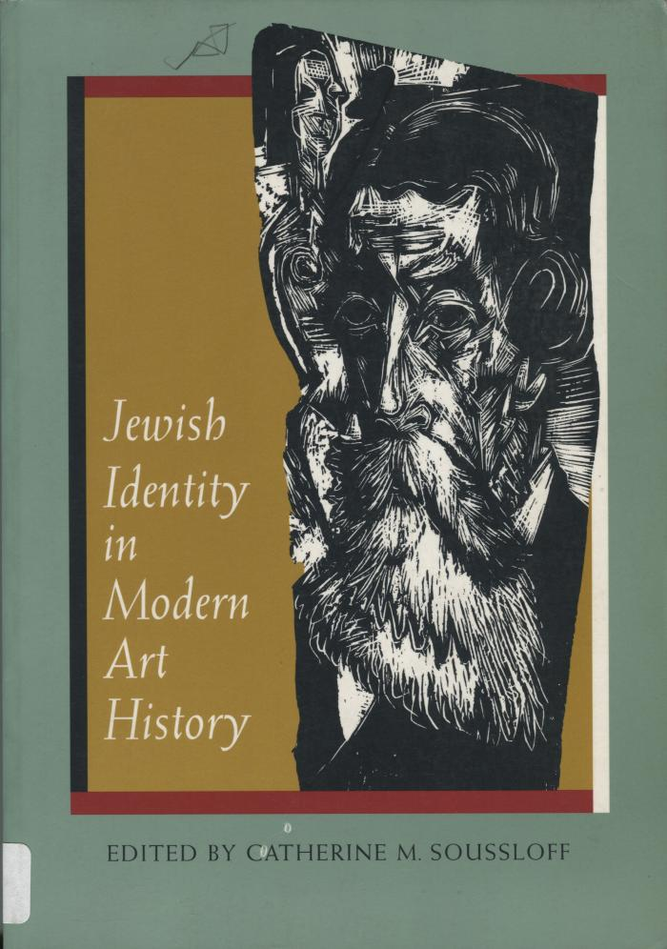
Jewish identity in Modern Art history (BI04678)

