Slide 1
1- A roman on a nomen
2- Heymishe bilder
3- Di yudishe velt
A zamlung ertselungen (BY02884B)

Slide 2
1- Der gelekhter
2- Araynfir in di metafizik (BY00725A)

Slide 3
1- Di gehaymnisn fun di yapanishn shpionazh - 2- Yud zis (BY03396A)

Slide 4
1- Di klatshe
2- Der luft-balon
3- Der fish (BY02661A)

Slide 5
1- Di klole fun sheynkayt
2- Treytl (di geshikhte fun a shtetl) (BY02923B)

Slide 6
1- Di takse
2- Di klatshe
3- Fishke der krumer (BY02555A)

Slide 7
1- Fishke der krumer
2- Mayses binyomin hashlishi
3- Dos vintshfingerl
4- Dos klayne mentshele (BY02554A)

Slide 8
1- Hundert protsent
2- Vegen ziben gehangene (BY02829B)

Slide 9
1- Idishe romanen
2- Stempeniu (BY04027A)

Slide 10
1) Ihr shvester
2) A sreyfe
3) Der letster (BY01652A)

Slide 11
1- Luft balon
2- A megile tsu yudishe tsures (BY02548A)

Slide 12
1- Mayses binyomin hashlishi
2- Der priziv (BY02663A)

Slide 13
1- Mendele Moykher Sforim
2- Dos klayne menshele (BY02660A)

Slide 14
1- Mishke un Mashke
2- Dramen
3- Sholem Bayis
4- Moyshe soldat (BY02148A)

Slide 15
1- Shabes un yontev
2- Elteren un kinder (BY02665A)

Slide 16
1- Smolenskins biografie
2- Reb Elkhonon un andere ertselungen (BY01991A)

Slide 17
1) Vilner baal-habayisil (drama in 4 akten)
2) Tsezayt un tseshprayt (bilder funem yudishen leben in 3 akten)
Elishe ben aboye (drama in 4 akten) (BY00290A)

Slide 18
1- Yudel
2- Shabesdige zmires
3- Peyrek shiro (BY02662A)

Slide 19
2-3 : Ertselungen
4 : Geshtalten
5-6 : Brif fun rusland (BY03301A)

Slide 20
4th Jewish Culture Festival in Cracow (BI03061)

Slide 21

32 WIDOKI PRZEDWOJENNEJ ZBURZONEJ I DZISIEJSZEJ (08987)

Slide 22
33 noveln (BY00842A)

Slide 23
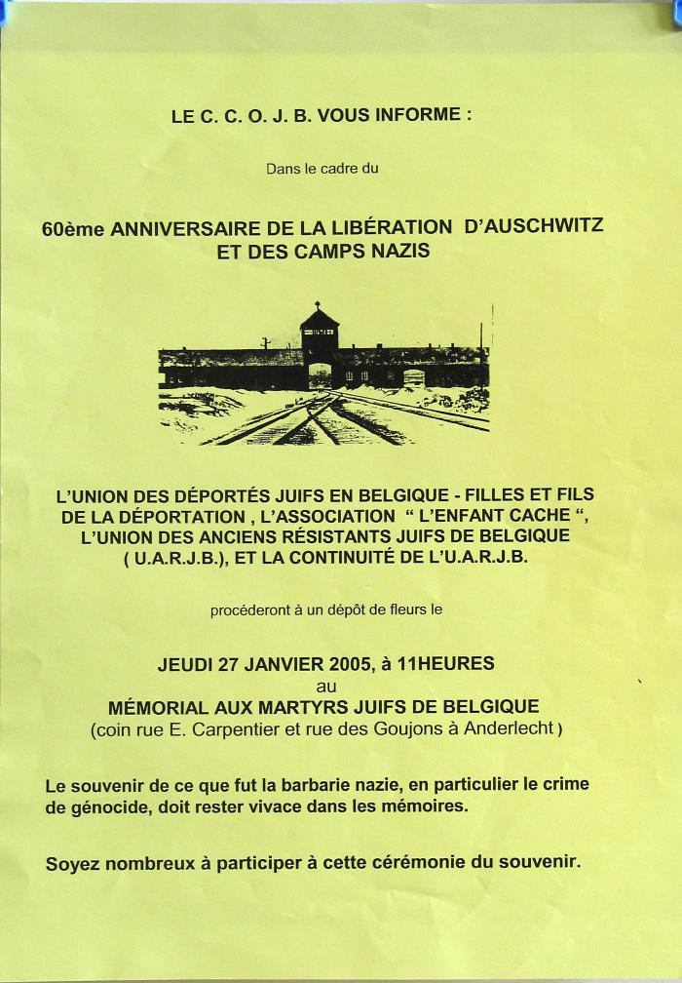
60e anniversaire de la libération d'Auschwitz et des camps nazis (07771)

Slide 24

60e anniversaire de la libération d'Auschwitz et des camps nazis (07772)

Slide 25
100 tanes tsu amerike (BY01228A)

Slide 26
100 taynes tsu amerike (BY02180A)

Slide 27
200 lat Zydow w Lodzi (BI07010)

Slide 28
1905 (ershter tayl) (BY01385A)

Slide 29
1863 (BY00118A)

Slide 30
Abelar un heluiz (BY02238A)

Slide 31
Abintel ertselungen (BY02388A)

Slide 32
A boym in vint (BY00278A)

Slide 33
Adam mitskevitsh (BY02411A)

Slide 34
A duel (BY01927A)

Slide 35
Aeroplan (BY03106A)

Slide 36
A fentster tsu der velt (BY00624A)

Slide 37
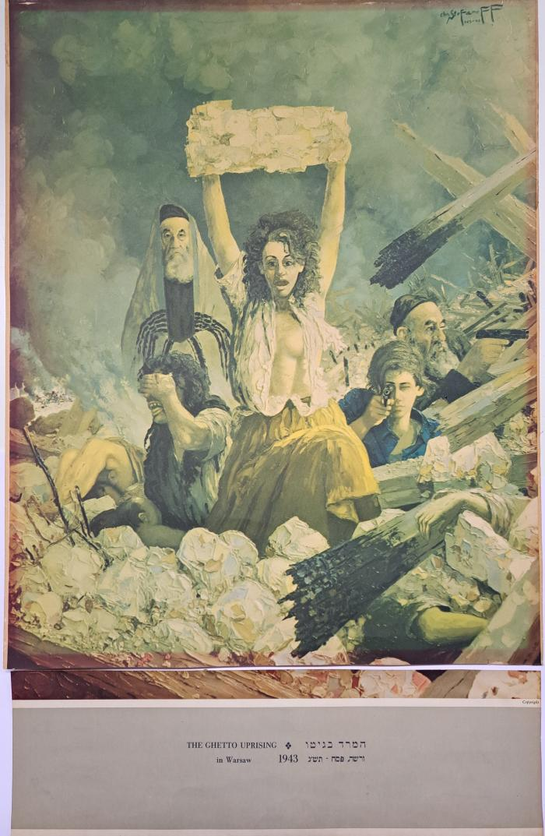
affiche découpée "the ghetto uprising in Warsaw 1943" par Christo Stefanoff (18274)

Slide 38
Afrike (ershtes bukh) (BY03356B)

Slide 39
A gast (BY02727A)

Slide 40
A groyser remiz (BY02197A)

Slide 41
Ahin un tsurik (BY02398A)

Slide 42
Akatsies blien (BY03052A)

Slide 43
A khinezish yingl (BY01947A)

Slide 44
A lamtern far yerukhmken (BY01197A)

Slide 45
Al dos guts (BY00677A)

Slide 46
Aldos guts far aykh (BY02342B)

Slide 47
Ale fentster tsu des zun (BY02365A)

Slide 48
A legende vebt zikh (BY02941A)

Slide 49
Ale verk fun Dovid Frishman (ershter tayl) (BY03150A)

Slide 50
Algemayne geshikhte fun yidishn folk (in tsen bend) (band I) (BY01245B)

Slide 51
ALIEN AND UNPLEASANT (BI08564)

Slide 52
Alle verk fun mendele moykher sforim (BY02672A)

Slide 53
Almanakh fun der poylisher literatur (BY00224A)

Slide 54
Alroyne (BY02987A)

Slide 55
Alter (BY01184A)

Slide 56
Alt-nay-kasrilevke (BY04029A)

Slide 57
Amerike (BY00360A)

Slide 58
Amerike (BY02657A)

Slide 59
Amnon un tomer (BY02399A)

Slide 60
Amol in amerike (BY03497A)

Slide 61
Amol in a yoyvl (BY00135A)

Slide 62
Anarkhie nokhn kapitalizm (BY01682A)

Slide 63
And I still see their faces (BI05212)

Slide 64
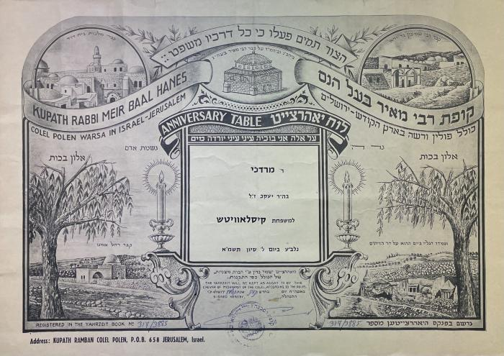
Anniversary Table (15034)

Slide 65
Anshl der zaliaznik (BY02426A)

Slide 66
Anton tshekhov (BY01647A)

Slide 67
Antosha un andere (BY02915A)

Slide 68

Appearances of normality
Commemorating the 60th anniversary of the liquidation of the Lodz ghetto (BI03891)

Slide 69
A rayze (BY03026A)

Slide 70
A rayze arum di velt oyfn ershtn aeroplan (BY01583A)

Slide 71
A rayze unter der erd (BY01582A)

Slide 72
Arbayter-lukh oyf dos yor 1921 (BY00172A)

Slide 73
Arbayter-lukh - yor 1924 (BY00173A)

Slide 74
Arbeter-lukh oyf dos yor 1925 (BY00174A)

Slide 75
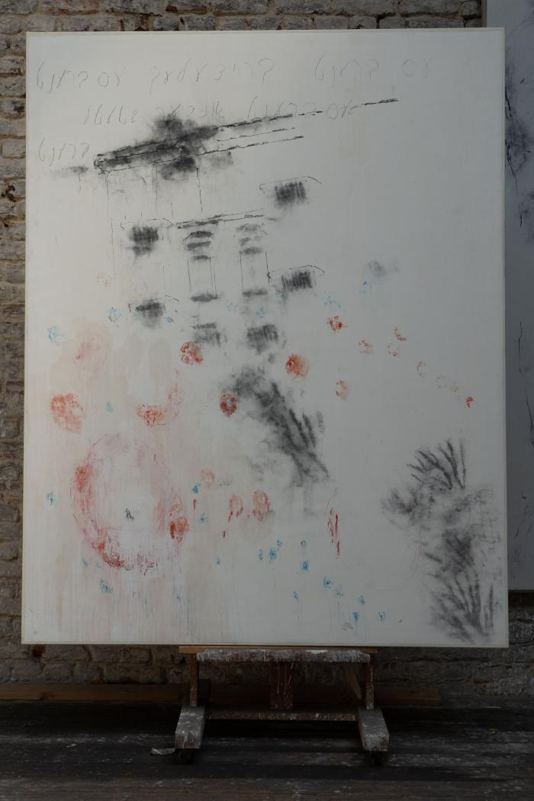
Arié Mandelbaum, Le Ghetto en feu (18082)

Slide 76
Aropeishe literatur (2-ter band) (BY03909A)

Slide 77
Art in Jewish society (BI09339)

Slide 78
Artur Markowicz 1872-1934
Wystawa monograficzna (BI04976)

Slide 79
Artur shopenoyer (BY00916A)

Slide 80
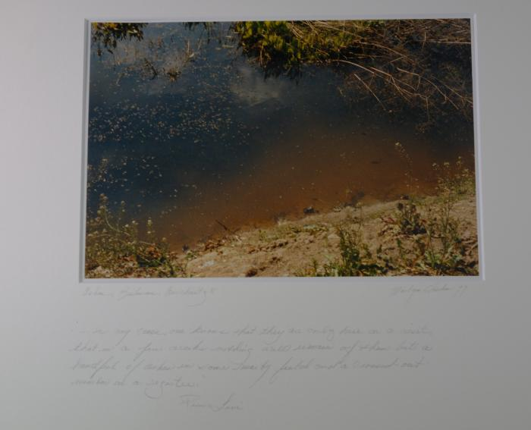
Ashes, Birkeneau, Auschwitz II. (11842)

Slide 81
A shtetil (BY01528A)

Slide 82
A shtetl baym san (BY02904A)

Slide 83
A shtot oyf der volge (BY03437A)

Slide 84
A shturmish lebn (BY02138A)

Slide 85
Auschwitz 1940-1945 (BI03342)

Slide 86
A yid fun klementov dertseylt : (BY00378A)

Slide 87
A yid tsvishn poyerim (BY01172A)

Slide 88
Ayropeishe literatur (BY00217A)

Slide 89
Ayropeishe literatur (BY03851A)

Slide 90
Ayzenbangeshikhtes (BY04040A)

Slide 91
A zegl in vint (BY02887A)

Slide 92
Azoy hot geredt zaratustra (BY02705A)

Slide 93
A zumer (BY00840A)

Slide 94
BABINIEC (BI08788)

Slide 95
Babit (BY02091A)

Slide 96
Bagaysterung (BY00681A)

Slide 97
Balut (BY03708A)

Slide 98
Bambi (BY02771A)

Slide 99
Banayte teg (BY00924A)

Slide 100
Barg aroyf (BY01870A)

Slide 101
Barimte yidishe froyen (BY03343B)

Slide 102
Batuala (BY02340A)

Slide 103
Bay der arbet klingt dos lid (BY02343A)

Slide 104
Bay di taykhn fun mazovye (BY00755A)

Slide 105
Baym breg (BY01299A)

Slide 106
Baym opgrunt (BY00322B)

Slide 107
Baynakht
Der vald roysht (BY03503A)

Slide 108
Bedziecie mieszkac w szalasach przez siedem dni (III Mojz. 23,42) (BI01656)

Slide 109
Beethoven (BY03744A)

Slide 110
Beethoven (BY03745B)

Slide 111
Bergeret in pariz (BY03177A)

Slide 112
Berl Prager in land fun raynkayt (BY00024A)

Slide 113
Ber mayzels (BY03606A)

Slide 114
Bernshtayn's nayer yudisher folks-brifenshteler (BY00744A)

Slide 115
Biblishe gezangen (finf bikher) (BY03490B)

Slide 116
Biblishe un historishe dramen (BY00353A)

Slide 117
Biologishe tragedie fun der froy (BY02697A)

Slide 118
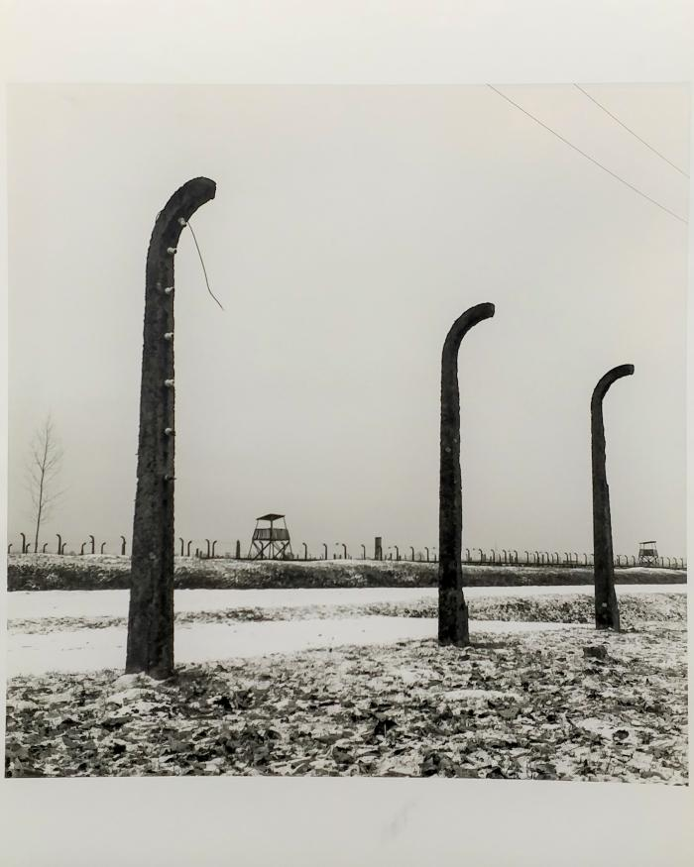
Birkenau (10612)

Slide 119
Bleter far geshikhte (BY00738B)

Slide 120
Bleter far geshikhte (BY00739A)

Slide 121
Bleter far geshikhte (BY00740B)

Slide 122
Bleter far geshikhte (BY00976B)

Slide 123
Bleter vegn vilne (BY00730B)

Slide 124
Bletlekh geshikhte (BY03943A)

Slide 125
Borvese trit (BY02880A)

Slide 126
Boston (driter band) (BY02821A)

Slide 127
Boykhtifus (BY03960A)

Slide 128
Boznice Drewniane (BI01495)

Slide 129
Breslauer Juden 1850-1944 (BI00786)

Slide 130
Brider (BY02948A)

Slide 131
Brief fun rusland (BY03306A)

Slide 132
Briv tsum arbeter (BY02830A)

Slide 133

Bruno Schulz 1892 - 1942 (BI05059)

Slide 134
Bundistn (1ter band) (BY03024A)

Slide 135

Carmel d'Auschwitz 20-02-1989 / 22-02-1990 Un an de mensonges !!! (08752)

Slide 136
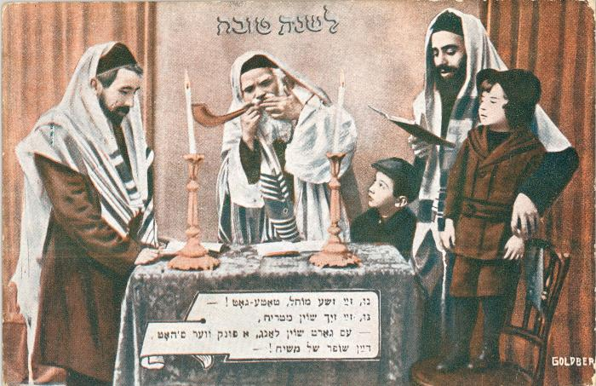
Carte de vœux de bonne année - Rosh Hashanah (04647)

Slide 137
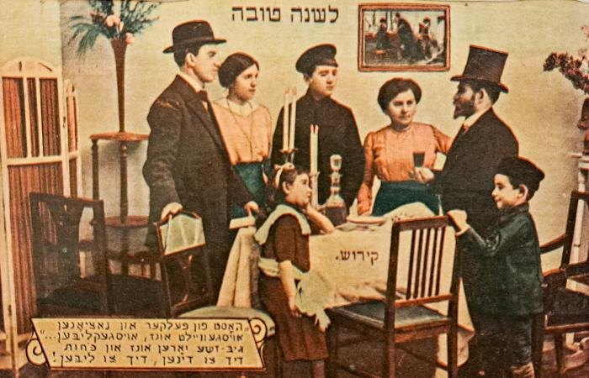
Carte de vœux de bonne année - Rosh Hashanah (04656)

Slide 138
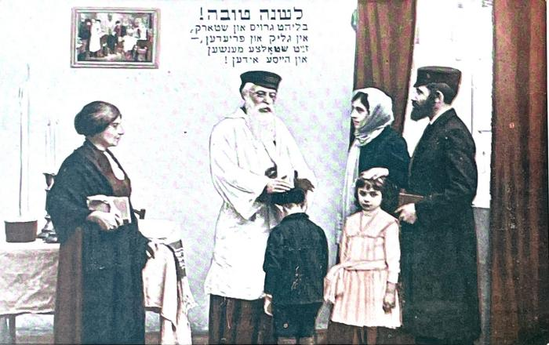
Carte de vœux de bonne année - Rosh Hashanah (04657)

Slide 139
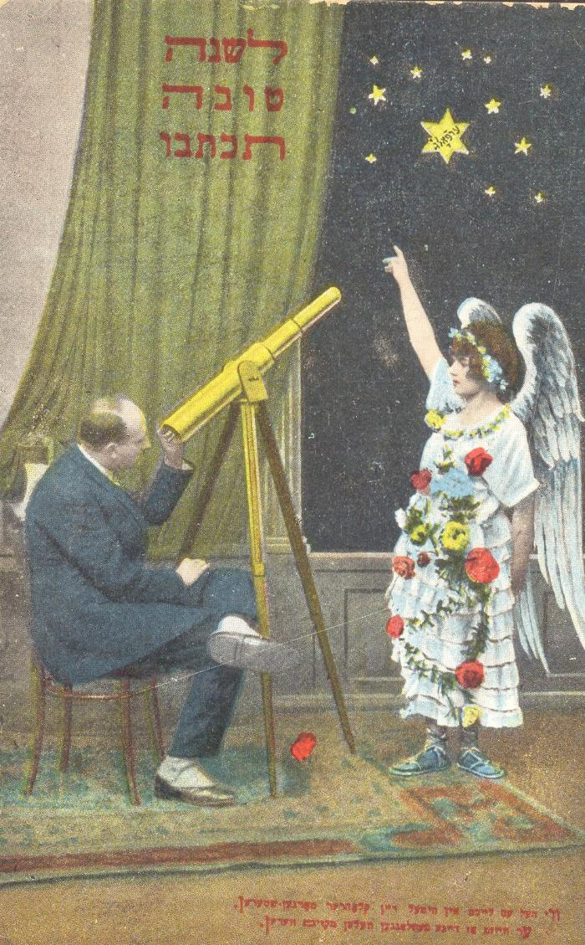
Carte de vœux de bonne année - Rosh Hashanah (13337)

Slide 140
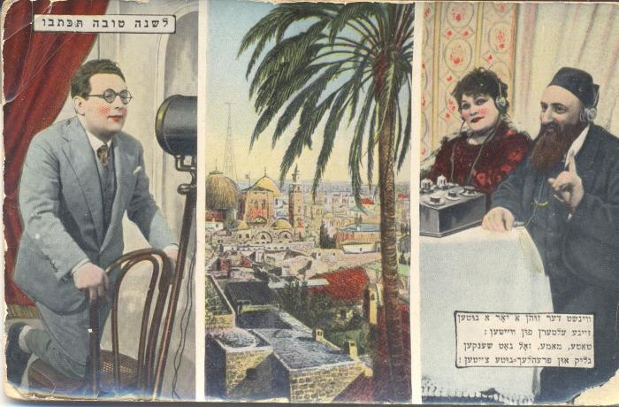
Carte de vœux de bonne année - Rosh Hashanah (13338)

Slide 141
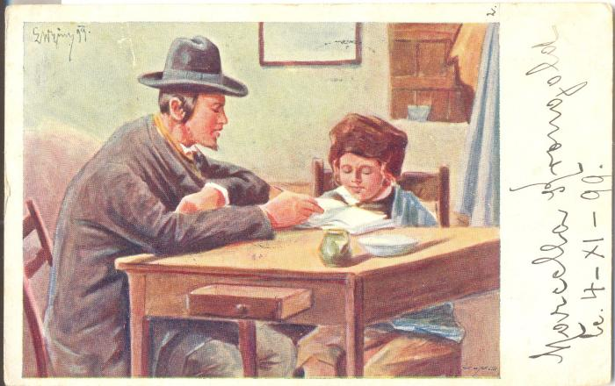
Carte postale d'un père et son fils lisant (14160)

Slide 142
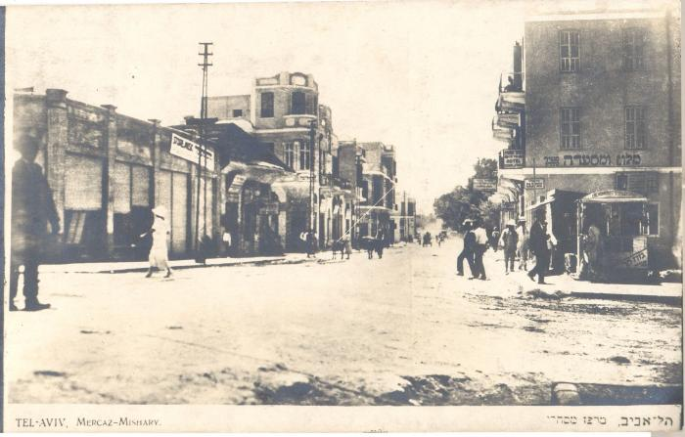
Carte postale "TEL-AVIV, Mercaz- Mishary" (14140)

Slide 143
Christian Poles and Jews in mutual perception - Towards an archaeology of shared and divided memory
Wzajemne postrzeganie chrzescijan i Zydow na ziemiach polskich (BI03928)

Slide 144
Cmentarze zydowskie w Polsce : nagrobki i epitafia (BI01650)

Slide 145
Cmentarz Powazkowski w Warszawie (BI01625)

Slide 146
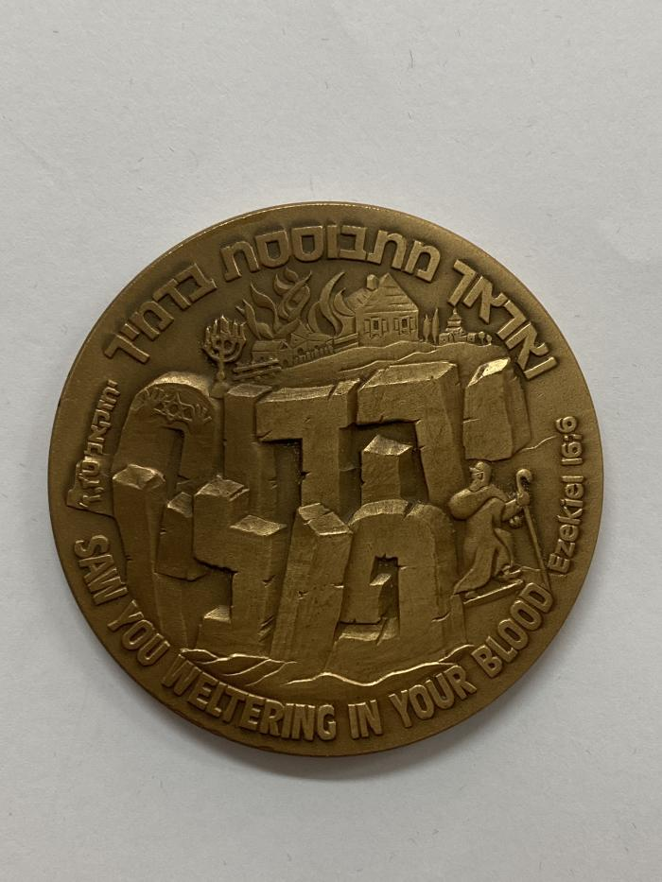
Communauté juive polonaise (02330)

Slide 147

Comprendre les crimes de haine antisémites et répondre aux besoins des communautés juives en matière de sécurité (BI11772)

Slide 148
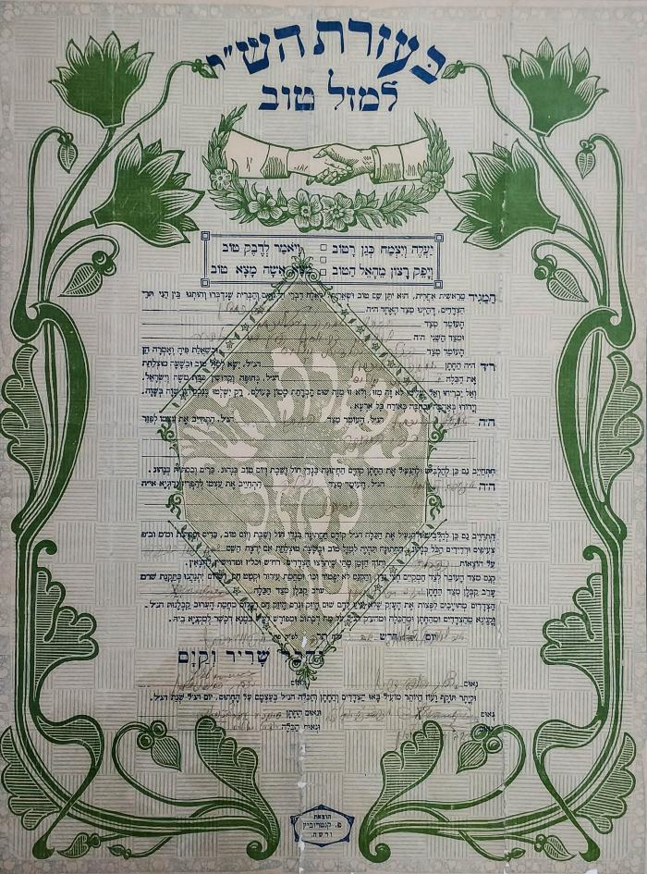
Contrat de fiançailles (00623)

Slide 149
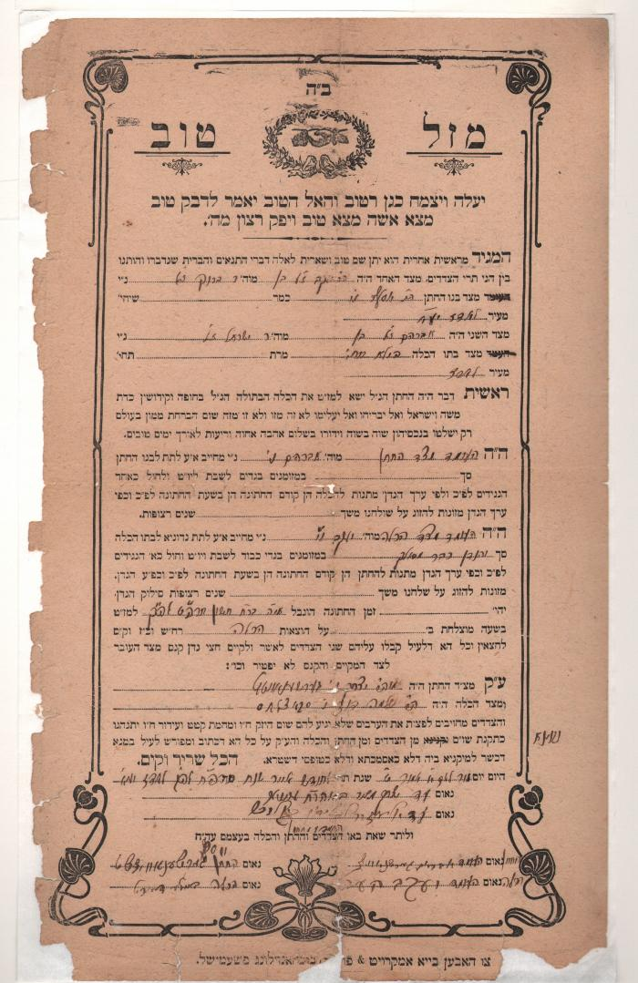
Contrat de fiançailles Brygier-Bajla (04130)

Slide 150
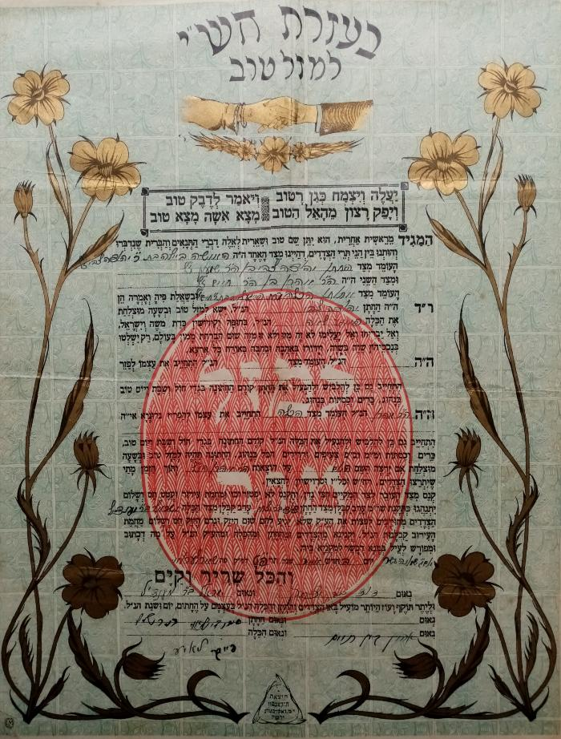
Contrat de fiançailles Feiga-Tsvi. (00465)

Slide 151
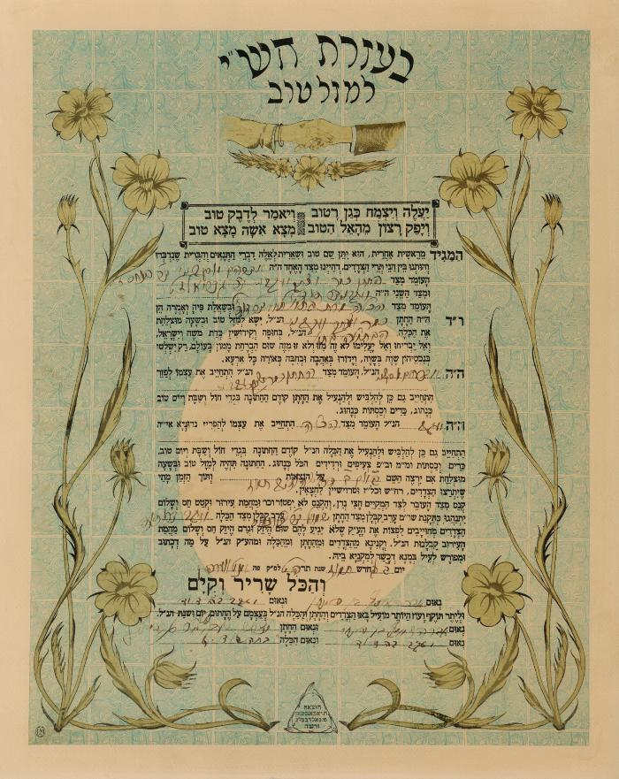
Contrat de fiançailles Zimmerman-Saposnik (06338)

Slide 152
Cooking the Polish-Jewish way (BI04847)

Slide 153
Cymes (BI03298)

Slide 154
Daniel (BY01531A)

Slide 155
Danko (BY00900A)

Slide 156
Danton (BY03747A)

Slide 157
Darvinizm un ateizm (BY00928A)

Slide 158
Darvinizm un ateizm (BY01007A)

Slide 159
Dawna Pocztowka Zydowska (BI05301)

Slide 160
Dawna sztuka zydowska w Polsce (BI03930)

Slide 161
Dayn kerper gehert dir (BY04002A)

Slide 162
Dem khavers froy (BY01770B)

Slide 163
Dem makhsheyfes talmid (BY02988A)

Slide 164
Der 9-ter november (BY03568B)

Slide 165
Der Alef-beys fun yudentum (ershter band) (BY03367A)

Slide 166
Der amerikaner milyoner (BY02835B)

Slide 167
Der ametistn-ring (BY03180A)

Slide 168
Der anarkhist (BY03570A)

Slide 169
Der arumgang un di flege fun zoygkind (BY03847A)

Slide 170
Der blinder muzikant (BY03504A)

Slide 171
Der bobes oytser (BY00386A)

Slide 172
Der deklamator (BY03802A)

Slide 173
Der emes iber erets-yisroeyl (BY03173A)

Slide 174
Der emes vegn ratnrusland (BY01944A)

Slide 175
Der emes vegn ratnrusland (BY01945A)

Slide 176
Der eybiker yid (BY03084A)

Slide 177
Der falsher neron (dos tsvayte bukh) (BY03116A)

Slide 178
Der familien-fraynd (tsvaytes bukh) (BY02927A)

Slide 179
Der fashizm (BY02753A)

Slide 180
Der foter (BY02797A)

Slide 181
Der foter un der zuhn (BY00499A)

Slide 182
Der froyen gan-edn (BY00562A)

Slide 183
Der gedank (BY00159A)

Slide 184
Der gertner (BY01789A)

Slide 185
Der gibor in keyten (BY01279B)

Slide 186
Der gibor in keytn (BY01216
B)

Slide 187
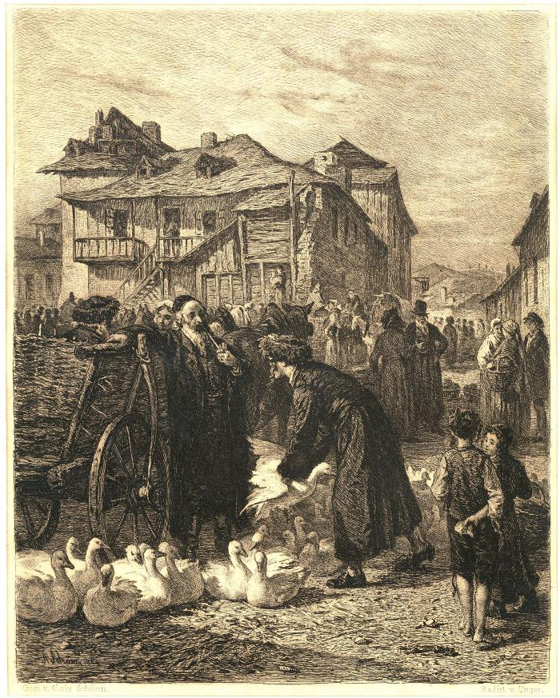
Der Gänsemarkt in Krakau (03771)

Slide 188
Der gold (BY02245A)

Slide 189
Der goyrl fun mentsh (BY02355A)

Slide 190
Der gubernator (BY00145A)

Slide 191
Der haknkrayts (BY02931A)

Slide 192
Der held fun unzer tsayt (BY02230A)

Slide 193
Der historisher materializm un zayne kegner (BY03196A)

Slide 194
Der hoyz-fraynd (BY02928A)

Slide 195
Der kamf far velt-hegemonie (ershter tayl) (BY02072B)

Slide 196
Der kamf mit der natur (BY00653A)

Slide 197
Der kayser fun portugal (BY02135A)

Slide 198
Der kern fun ale mayne lider (BY03731B)

Slide 199
Der khaver (BY02349A)

Slide 200
Der kiever blut-bilbul (BY02728A)

Slide 201
Der klayner pier (BY03169A)

Slide 202
Der korbn fun fanatizm (BY00379B)

Slide 203
Der literat (BY01600B)

Slide 204
Der man vos zukht libe (BY03136A)

Slide 205
Der mentsh hot gezigt (BY00797A)

Slide 206
Der mentsh vet gut zayn (BY00095A)

Slide 207
Der moderner shed (BY01510A)

Slide 208
Der nayer dur (BY02350A)

Slide 209
Der novi (BY00932B)

Slide 210
Der novi (BY00933B)

Slide 211
Der opgrunt roysht (BY00923A)

Slide 212
Der oyfshtand in bialystoker geto (BY02403A)

Slide 213
Der oyfshtand in bilisteqer geto (BY02675A)

Slide 214
Der oyfshtand in varshever geto (BY00968A)

Slide 215
Der oyfshtand in varshever geto (BY02401A)

Slide 216
Der oyfshtand in varshever geto (BY02402A)

Slide 217
Der pingvinen-inzl (BY03181A)

Slide 218
Der prints un der betler (BY01891A)

Slide 219
Der rasiker arier (BY04053A)

Slide 220
Der ratsionalizator Elie Vishniak (BY01554A)

Slide 221
Der ratsionalizator izak Glitsenshteyn (BY00756A)

Slide 222
Der redaktor (BY01377A)

Slide 223
Der royter handl drot (BY03564B)

Slide 224
Der royter rayter (BY00678A)

Slide 225
Der Sheydim-tants (BY03635A)

Slide 226
Der shtiler don (BY03965A)

Slide 227
Der shvartser monakh (BY01925A)

Slide 228
Der tehilim-yid (BY00327B)

Slide 229
Der toyt fun di geter (BY02592A)

Slide 230
Der toyt fun kapitan reyli (BY03665A)

Slide 231
Der toyt in venedig (BY02457B)

Slide 232
Der toytn-tants (BY03572A)

Slide 233
Der tsaytungs-shrayber (BY02779A)

Slide 234
Dertseylungen (BY02609A)

Slide 235
Dertseylungen (BY02658A)

Slide 236
Der tsvayuntsvantsikster oygust (BY00316A)

Slide 237
Der tunel (BY03565A)

Slide 238
Der tunel (finfter tayl) (BY03566B)

Slide 239
Dervakhung (BY01113A)

Slide 240
Dervakhung (BY03326A)

Slide 241
Der vashtsukht (BY01876A)

Slide 242
Der vas krigt di patsh (BY00156A)

Slide 243
Der vayser toyt (BY02140A)

Slide 244
Der vayser toyt (BY02141A)

Slide 245
Der veg fun payn (BY01271A)

Slide 246
Der veg kayn buenos-ayres (BY02170A)

Slide 247
Der veg oyf varshe (BY01319A)

Slide 248
Der veg tsum himl (BY03837A)

Slide 249
Der veg tsu zikh (BY00340A)

Slide 250
Der veg tsu zikh (BY00375A)

Slide 251
Der vintsh-kontsert (BY01533A)

Slide 252
Der vos hot geblondzhet (BY02822B)

Slide 253
Der yam-volf (BY02085A)

Slide 254
Der yidisher konsonantizm (2 bender) (BY03293A)

Slide 255
Der yunger mentsh un zayn antviklung (BY03828B)

Slide 256
Der zeyde mendele (BY01212A)

Slide 257
Der zeyde
Zikhroynes fun mendeles tekhter (BY00039A)

Slide 258
Der zukher fun emes (BY02834A)

Slide 259
Di antshteyung fun religie un gloybn (BY03591A)

Slide 260
Di bakhurte (BY02346A)

Slide 261
Di bin Maya (BY00463A)

Slide 262
Di brider Shelenberg (BY03571A)

Slide 263
Di brukhe fun der erd (in tsvay bend) (BY01390B)

Slide 264
Di brukhe fun der erd (in tsvay bend) (BY01391A)

Slide 265
Di brukhe fun der erd (in tsvay bend) (BY01392A)

Slide 266
Di dialogn fun zherom coiniar (BY03167A)

Slide 267
Di eltste yidishe yishuvim in mizrakh-ayrope (BY02637A)

Slide 268
Di entshtayung fun kristentum (BY00942B)

Slide 269
Di ershte libe (BY01892A)

Slide 270
Di ershte yedies fun naturvisenshaft (BY02995B)

Slide 271
Di ershte yedies fun naturvisnshaft band I (BY02001B)

Slide 272
Di ferte vant (BY01229A)

Slide 273
Di ferte vant (BY02184A)

Slide 274
Di ferte vant (BY02185A)

Slide 275
Di froy (BY02790B)

Slide 276
Di froy fun di barikadn (Oktober) (BY03816A)

Slide 277
Di froy fun hayntikn rusland (BY01208A)

Slide 278
Di froy fun shtot (BY01618A)

Slide 279
Di froy un der sotsializm (ershter band) (BY00588A)

Slide 280
Di gasn-froy (BY02347A)

Slide 281
Di geheimnis fun der velt (BY01559A)

Slide 282
Di geshikhte fun der rusisher literatur (BY03433A)

Slide 283
Di geshikhte fun der rusisher revolutsie (BY01943A)

Slide 284
Di geshikhte fun der yidisher literatur (BY02945A)

Slide 285
Di geshikhte fun der yidisher literatur (BY03092B)

Slide 286
Di geshikhte fun der yidisher literatur (BY03148A)

Slide 287
Di geshikhte fun der yidisher literatur (BY03149B)

Slide 288
Di geshikhte fun der yidisher prese (BY03341)

Slide 289
Di geshikhte fun mayn kindhayt (BY01771A)

Slide 290
Di geshikhte fun sotsializm (ershter band) (BY03782A)

Slide 291
Di geshikhte fun sotsializm (ershter band) (BY03906A)

Slide 292
Di geshikhte fun yiden in poylen (BY01372A)

Slide 293
Di geshikhte fun yidishn folk (tsvayter tayl) (BY00248A)

Slide 294
Di geshikhte fun yidn in poylen (BY01364B)

Slide 295
Di geshikhte fu yidn in poyln (BY02404A)

Slide 296
Di goldene kayt (BY02832A)

Slide 297
Di Haydukn
Di dertseylungen fun adrian zografi (BY00070A)

Slide 298
Di henker (BY00518A)

Slide 299
Di higiene fun seksueler leben (BY03726A)

Slide 300
Di hitleristishe politik fun yidn-farnikhtung
In di yorn 1939-1945
Vi an oysdruk fun daytshishe imperializm (BY00083A1)

Slide 301
Di hitleristishe politik fun yidn-farnikhtung
In di yorn 1939-1945
Vi an oysdruk fun daytshishe imperializm (BY00083A2)

Slide 302
Di intelligentz fun blumen (BY02676A)

Slide 303
Di khakhamim fun Khelem (BY03280A)

Slide 304
Di khosanim (BY00802A)

Slide 305
Di kinder fun kapitan grant (dray tayl) (BY01602A)

Slide 306
Di Klatshe (BY02551A)

Slide 307
Di komunistishe bavegung tsvishn der yidisher arbetndiker bavegung in poyln (BY01597A)

Slide 308
Di kreftigungs-mitlen in'm geshlekhts-leben fun mener un froyen (BY01560A)

Slide 309
Di kroyn fun mitsrayim (BY03275A)

Slide 310
Di kunst fun libe (BY01571A)

Slide 311
Di kunst un literatur in sovyet-rusland (BY01206A)

Slide 312
Di legende fun yesta berling (tsvay tayln) (BY02136A)

Slide 313
Di letste (BY01478A)

Slide 314
Di letste nesie (BY02930A)

Slide 315
Di libe in der natur (BY00591B)

Slide 316
Di libe in der natur (BY00592B)

Slide 317
Di libe in der natur (BY00593B)

Slide 318
Di libe in der natur (BY00595A)

Slide 319
Di libe in der natur (BY00596A)

Slide 320
Di libe in der natur (BY00597A)

Slide 321
Di libe in der natur (ershter band, bukh fir) (BY01257A)

Slide 322
Di literarishe shtremungen in ratrusland fun 1927 biz 1917 (BY03067A)

Slide 323
Di madam vil nisht hoben kayn kind (BY01467)

Slide 324
Di mame ester rokhl (BY01057A)

Slide 325
Di mame ester rokhl (BY01817A)

Slide 326
Di mashinen tseshterer (BY01800B)

Slide 327
Di mashinen tseshterer (BY01801A)

Slide 328
Di maskes fun ervin Rayner (BY01471B)

Slide 329
Di mishpokhe pikuda (BY00961A)

Slide 330
Di mishpokhe shteynberg (BY01061A)

Slide 331
Di mishpokhe shteynberg (ershter band) (BY01038A)

Slide 332
Di muter (BY00341A)

Slide 333
Di naye adam un khave (BY03429A)

Slide 334
Di nayste geshikhte fun yidishn folk (ershter band) (BY01254B)

Slide 335
Di nayste geshikhte fun yidishn folk (in dray bend) (band. II) (BY01241B)

Slide 336
Di nayste geshikhte fun yidishn folk (in dray bend) (band. III) (BY01242B)

Slide 337
Di religion fun kapital (BY02162A)

Slide 338
Di remilitarizatsye in mayrev-daytshland un di rol fun hitleristishe generaln (BY00084A)

Slide 339
Di revolutsie (BY02172A)

Slide 340
Di revolutsionere froy (BY00689A)

Slide 341
Di sheydim-ozere (BY01826A)

Slide 342
Di shkhite (BY00814B)

Slide 343
Di shoyshpilerin (BY02318A)

Slide 344
Di shtim fun blut (BY02156A)

Slide 345
Di shtremungen in der literatur fun XIX yorhundert (BY00763A)

Slide 346
Di shul fun khemie (BY00313B)

Slide 347
Di sibe (BY03347B)

Slide 348
Di sotsiologie fun kunst (BY03289B)

Slide 349

Distinguished jewish artists from the collection of David Malek and Signum Foundation (BI03889)

Slide 350
Di umgekumene shrayber fun di getos un lagern un zeyere verk (BY02406A)

Slide 351
Di untererdishe kukhut (BY02700A)

Slide 352
Di velt-geshikhte (1ter band) (BY01175B)

Slide 353
Di velt-retenishn (BY01331B)

Slide 354
Di velt-retenishn (BY02027A)

Slide 355
Di vildbliendike yugnt (BY03498A)

Slide 356
Di vilde tsilke (BY02872A)

Slide 357
Di volge falt arayn in kaspishn yam (BY03144A)

Slide 358
Di vunderlekhe lebnsbashraybung fun Shmuel aba abervo (BY02321A)

Slide 359
Di yesoydes fun der politisher ekonomye (BY00508A)

Slide 360
Di yesoydes fun der politisher ekonomye (BY00513A)

Slide 361
Di yidishe folks-geshikhte (ferde tayl) (BY01075B)

Slide 362
Di yidishe literatur biz di klasiker (BY02168A)

Slide 363
Di yidishe tokhter fun toledo (2 tayln) (BY03115A)

Slide 364
Di yidishe tragedie in der poylisher literatur (BY02407A)

Slide 365
Di yidn in shpanie (BY01431A)

Slide 366
Di yudishe folks-geshikhte (driter tayl) (BY01074B)

Slide 367
Di yudishe folkstimlekhe-geshikhte (tsvayter tayl) (BY01079B)

Slide 368
Di yudishe folkstimlikhe-geshikhte (fir tayln) (BY01256B)

Slide 369
Di yudishe geshikhte (driter band) (BY01550A)

Slide 370
Di yudishe geshikhte (finfter band) (BY03315A)

Slide 371
Di yudishe geshikhte (I - VI) (BY01076A)

Slide 372
Di yudishe geshikhte (tsvayter band) (BY01080B)

Slide 373
Di yudishe yugend (BY03450B)

Slide 374
Di zelbstshuts fun mentshlekhn organizm (BY03962A)

Slide 375
Dodye koval (BY00109A1)

Slide 376
Dodye koval (BY00109A2)

Slide 377
Dokumentn un materialn vegn oyfshtand in varshever geto (BY02410B)

Slide 378
Dor Oys dor ayn (2 bend) (BY02427A)

Slide 379
Dor Oys dor ayn (2-ter band) (BY02428A)

Slide 380
Dor oys dor ayn (in 2 bend -. ershter band) (BY02236A)

Slide 381
Dor un doyer (BY01307B)

Slide 382
Dos anarkhistishe meydl (BY02914A)

Slide 383
Dos buch fun poemen (BY02721A)

Slide 384
Dos bukh felyetonen (BY02612A)

Slide 385
Dos bukh fun bleter (BY03500B)

Slide 386
Dos bukh fun tsaar (BY00348A)

Slide 387
Dos bukh fun vortslen (BY03499B)

Slide 388
Dos ershte lid (BY01321A)

Slide 389
Dos farbrekhn fun silvestr bonar (BY03168A)

Slide 390
Dos fayer (BY00519A)

Slide 391
Dos ferdl fun baynakht (BY03532A)

Slide 392
Dos froyen-inzl (BY01290B)

Slide 393
Dos froyen-inzl (BY01291A)

Slide 394
Dos gesheft fun di Artamanovs (BY00886A)

Slide 395
Dos geshlekhts-leben fun mener un froyen (BY01558A)

Slide 396
Dos geshlekhts-lebn fun unzer tsayt (BY00566A)

Slide 397
Dos harts (BY00449A)

Slide 398
Dos harts (BY01264A)

Slide 399
Dos kapital (BY02421A)

Slide 400
Dos kind fun ayrope (BY01468A)

Slide 401
Dos lebn fun Klim Samgin (fertsik yor)
Band I (BY00883A)

Slide 402
Dos lebn fun Klim Samgin (fertsik yor)
Band II (BY00884A)

Slide 403
Dos lebn fun martirer (BY01174A)

Slide 404
Dos lebn fun Mikel Andzhelo (BY03748A)

Slide 405
Dos lebn hot mikh gelernt (BY03401A)

Slide 406
Dos lid funem oysgehargetn yidishn folk (BY03480A)

Slide 407
Dos lid iz geblibn (BY01312A)

Slide 408
Dos nakete yor (BY03143A)

Slide 409
Dos ponim fun dorf (BY02726A)

Slide 410
Dos shtetl (BY01803A)

Slide 411
Dos shturmishe lebn fun lazik roytshvaniets (BY02970B)

Slide 412
Dos tog-bukh fun dovid rubinovitsh (BY00969A)

Slide 413
Dos tog-bukh fun dovid rubinovitsh (BY03832A)

Slide 414
Dos yidishe ekonomishe lebn in der yidisher literatur (ershter heft) (BY02233A)

Slide 415
Dovid Alray (BY01156B)

Slide 416
Dramatishe shriften (BY04021A)

Slide 417
Dramatishe shriftn (BY00355A)

Slide 418
Dramatishe shriftn
1) Dos eybike lid - 2) Ver iz der ganev ? - 3) Mayn vaybs mehugas - 4) Shvester un brider
5) Di nekome - 6) Ven di bleter faln - 7) Der friling geyt - 8) Ven der tayvl lakht -
9) Der zeydns matone - 10) Di maksheyfe (BY00287B)

Slide 419
Dramatishe shriftn
1) Dos eybike lid
2) Ver iz der ganev ?
3) Mayn vaybs mehugas
4) Shvester un brider (BY00288A)

Slide 420
Dramatishe shriftn
1) Dos eybike lid - 2) Ver iz der ganev ? - 3) Mayn vaybs mehugas - 4) Shvester un brider
5) Di nekome - 6) Ven di bleter faln - 7) Der friling geyt - 8) Ven der tayvl lakht -
9) Der zeydns matone - 10) Di maksheyfe (BY00289A)

Slide 421
Dramen (BY03086A)

Slide 422
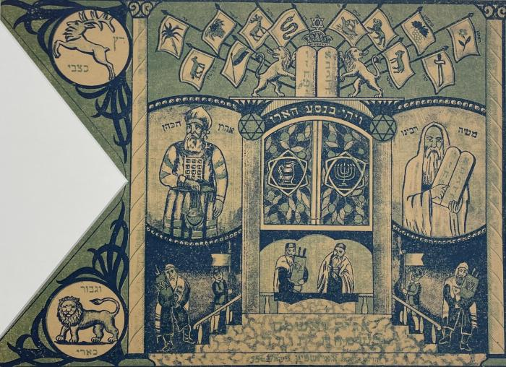
Drapeau pour Simhat Torah (01445)

Slide 423
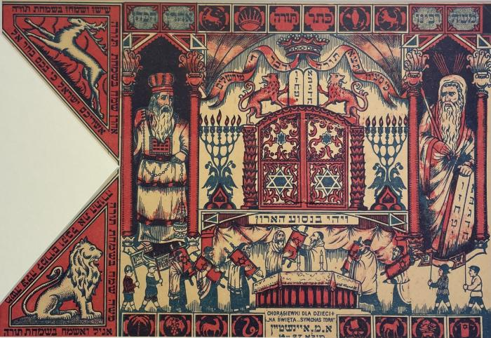
Drapeau Simhat Torah (01446)

Slide 424
Dray dertseylungen (BY03192B)

Slide 425
Dray literarishe doyres (BY03339B)

Slide 426
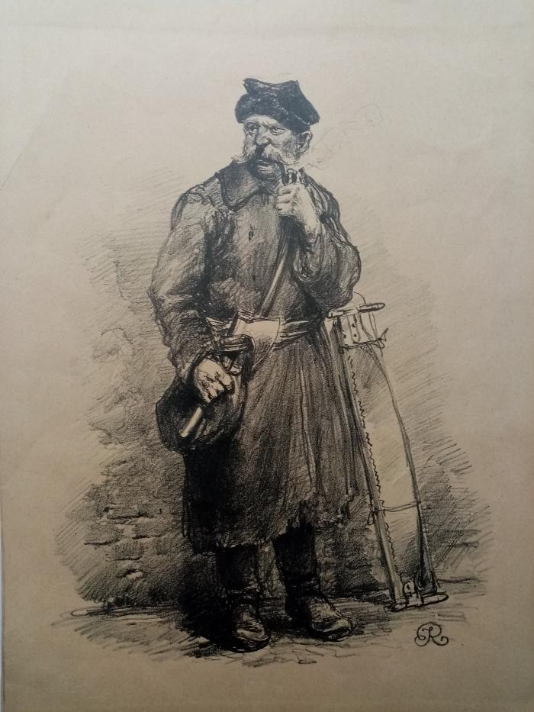
Drwal (02225)

Slide 427
Durkh barg un tol (BY01367A1)

Slide 428
Durkh shotn un shayn (BY01308A)

Slide 429
Dzhike gas (BY02367A)

Slide 430
Dzhiovani episkopo (BY01173B)

Slide 431
Dziennik getta - Rysunki
Z Podziemnego Archiwum Getta Warszawskiego (BI09143)

Slide 432
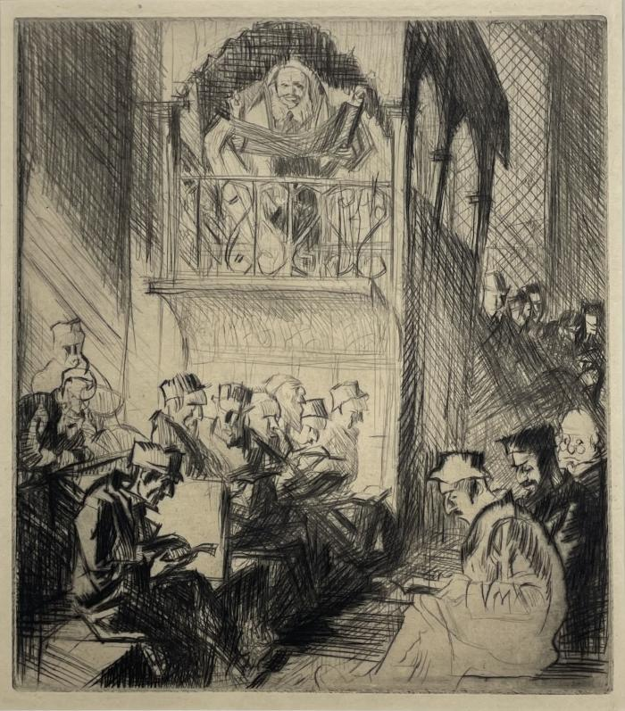
Eaux fortes de Frank Brangwyn illustrant le livre L'ombre de la Croix (01133)

Slide 433
Emil un di detektivn (BY03660A)

Slide 434
Enfance martyre (BI07798)

Slide 435
Epikurs gortn (BY02944A)

Slide 436
Erd (BY03525A)

Slide 437
Erets yisroeyl (BY00349A)

Slide 438
Erets Yisroeyl (BY00371A)

Slide 439
Erets-yisroeyl (BY02652A)

Slide 440
Erets yisroeyl oyfn shayd-veg (BY01750A)

Slide 441
Erev-friling (BY01742A)

Slide 442
Ernst Telman der kemfer far frayhayt un felker-frayndshaft. (BY03817A)

Slide 443
Ertselungen (BY00423A)

Slide 444
Ertselungen (BY03299A)

Slide 445
Ertselungen (BY03302A)

Slide 446
Ertselungen (BY03303A)

Slide 447
Ertselungen (BY03305A)

Slide 448
Ertselungen fun der frantseyzisher geshichte (BY02731A)

Slide 449
Ertseylungen (BY02607A)

Slide 450
Ertseylungen (BY02654A)

Slide 451
Ertseylungen (BY02655A)

Slide 452
Etisher sotsializm (BY01465A)

Slide 453
Everlasting memory (BI03337)

Slide 454
Eybik aynzam (BY02913A)

Slide 455
Eybik grin (BY01004A)

Slide 456
Falik in zayn hoyz (BY01190B)

Slide 457
Falik in zayn hoyz (BY01253A)

Slide 458
Farbrekhen un shtraf (2 bender) (BY01144A)

Slide 459
Far undzere kinder (BY00732B)

Slide 460
Far yugnt (BY02337A)

Slide 461
Far yugnt (BY02614A)

Slide 462
Faryungerung (BY01418A)

Slide 463
Felder grinen (BY03849A)

Slide 464
Felder grinen (BY03900A)

Slide 465
Felietonen (BY00421A)

Slide 466
Ferblondzhete (BY02929A)

Slide 467
Ferbrekhen un shtrof (1-ter band) (BY01548A)

Slide 468
Filozofie fun der kunst (BY02049A)

Slide 469
Filozofie fun der kunst (ershter band) (BY02029A)

Slide 470
Finstere vegn (BY02950A)

Slide 471
Flamen (BY00598A)

Slide 472
Flamen (BY00599A)

Slide 473
Flamen (BY00600A)

Slide 474
Flamen (2ter band) (BY00545A)

Slide 475
Flamen (tsveyter tayl) (BY00761A)

Slide 476
Flemlekh in der nakht (BY03604A)

Slide 477
Folkstimlekhe baladn (BY00108A)

Slide 478
Folkstimlekhe baladn (BY02855A)

Slide 479
Folks-univerzitet (ershter tayl) (BY02973A)

Slide 480
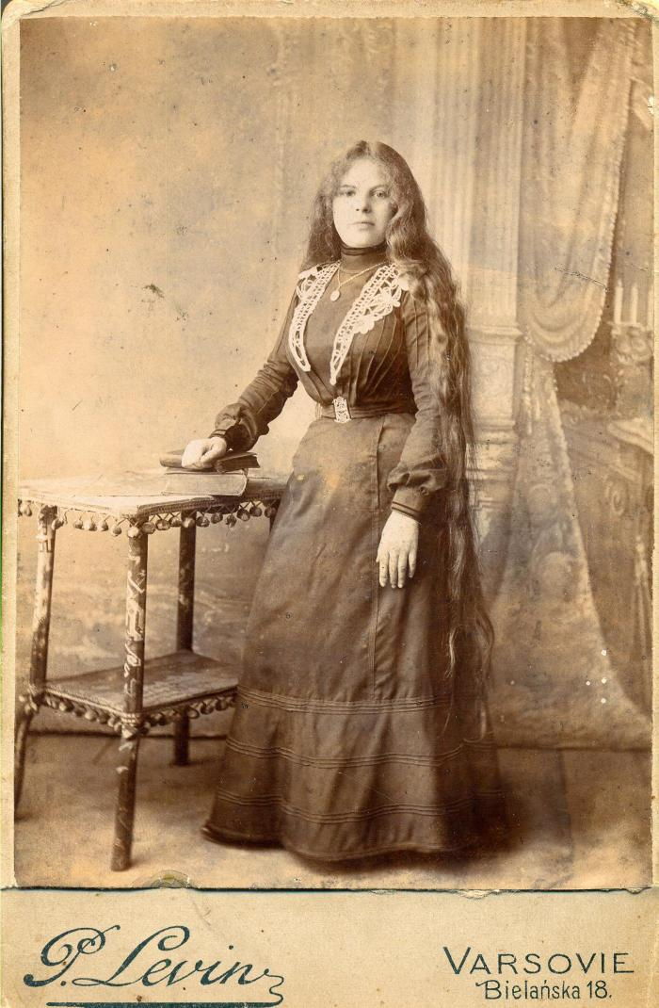
Fonds Otchakovsky (p003163)

Slide 481
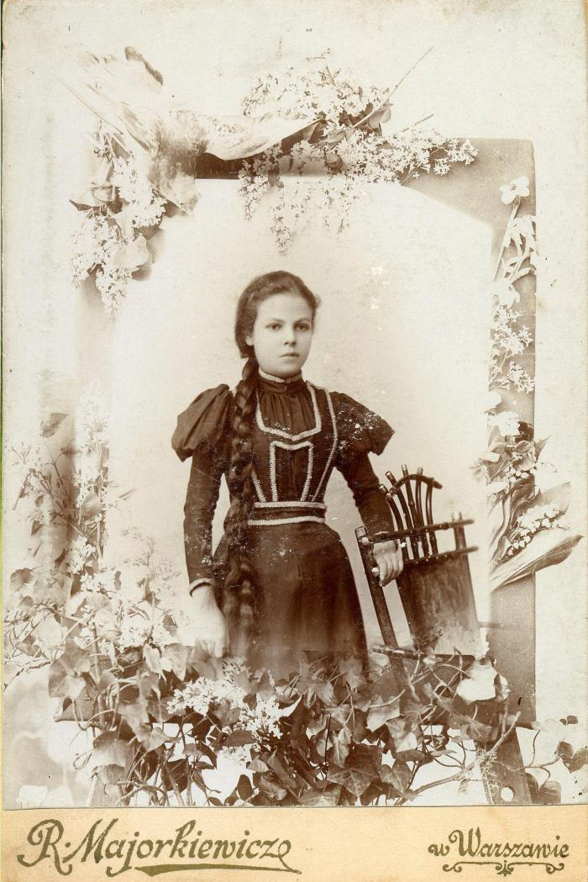
Fonds Otchakovsky (p003164)

Slide 482
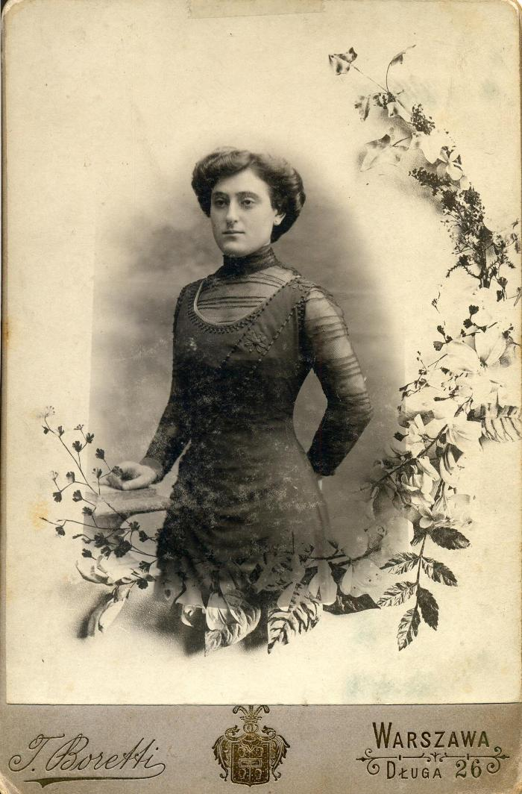
Fonds Otchakovsky (p003173)

Slide 483
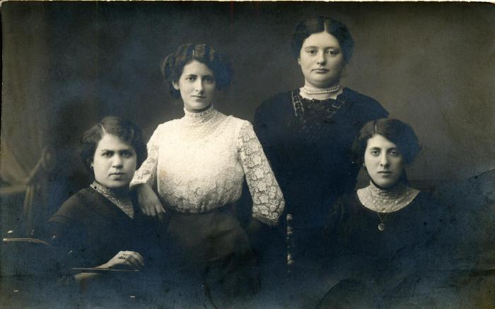
Fonds Otchakovsky (p003179)

Slide 484
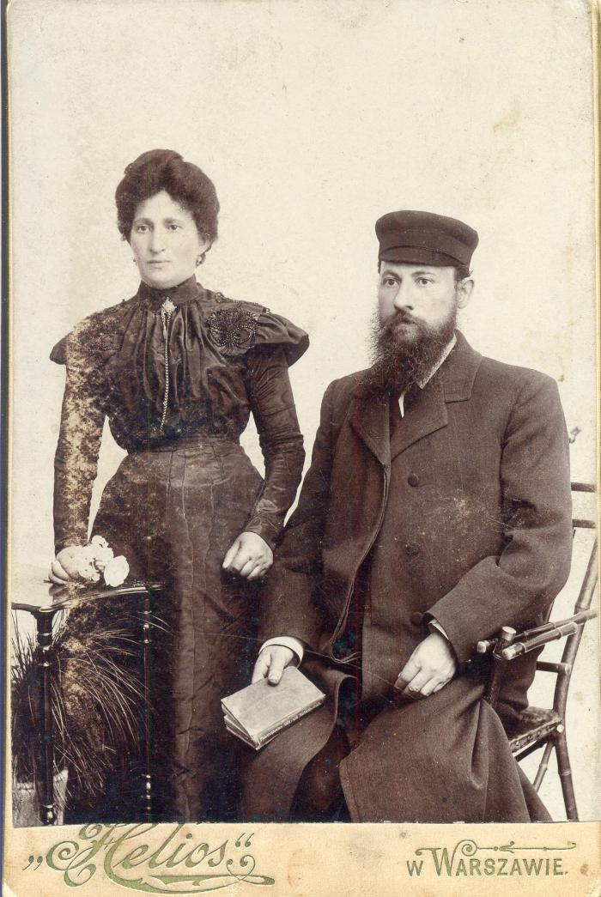
Fonds Otchakovsky (p003188)

Slide 485
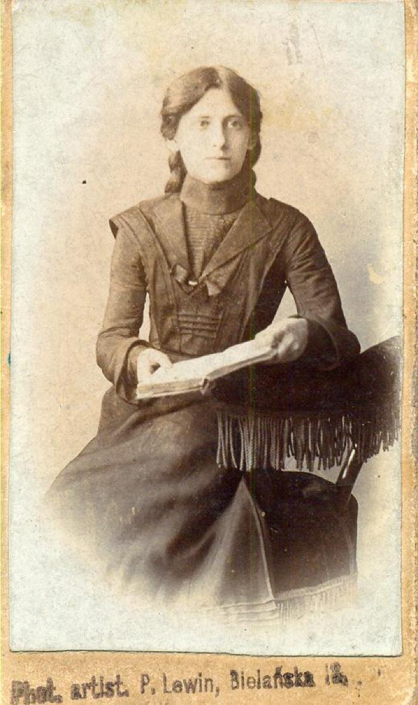
Fonds Otchakovsky (p003192)

Slide 486
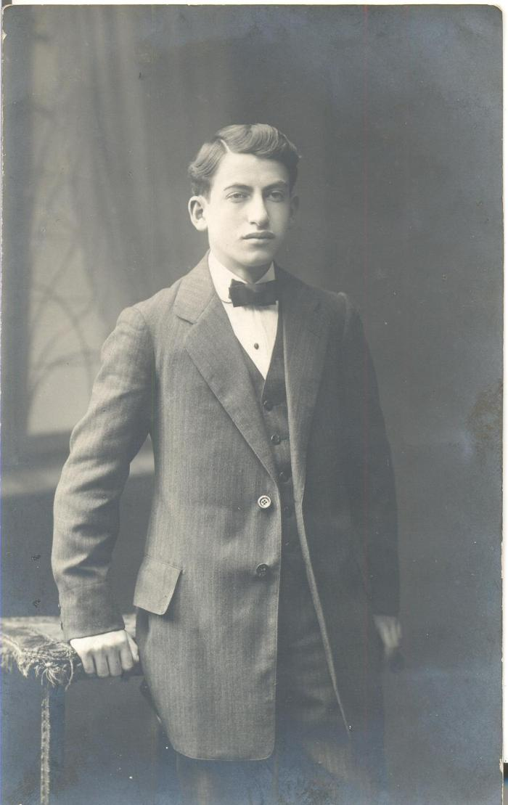
Fonds Otchakovsky (p003211)

Slide 487
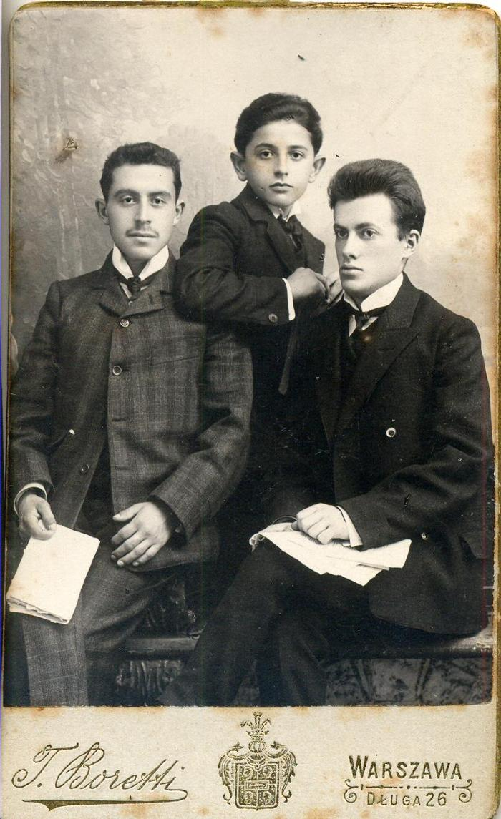
Fonds Otchakovsky (p003215)

Slide 488
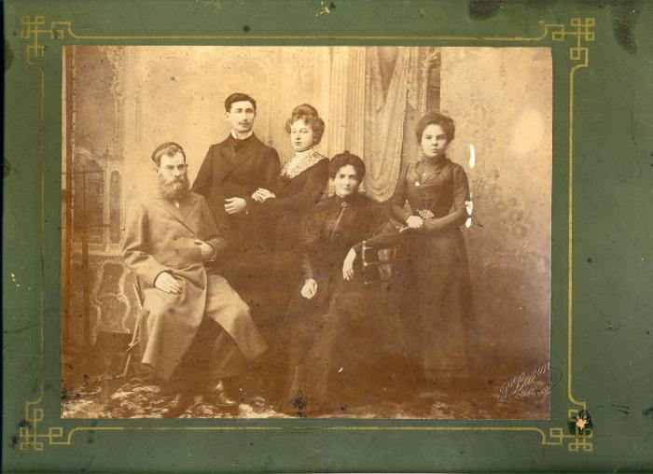
Fonds Otchakovsky (p003258)

Slide 489
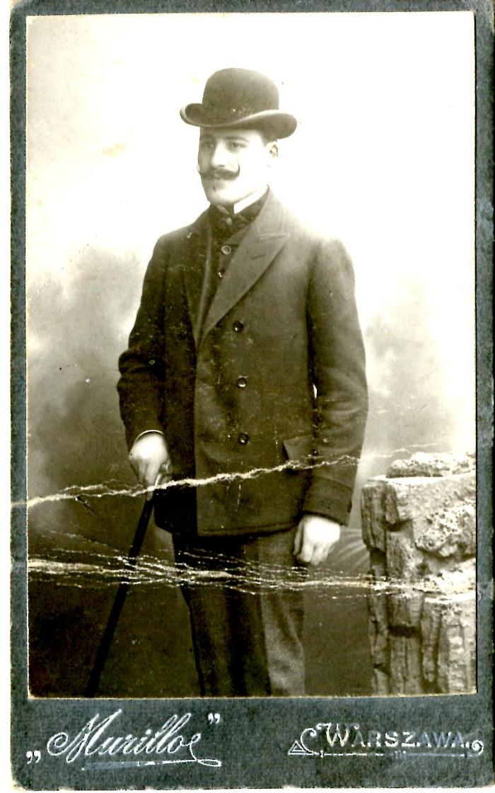
Fonds Otchakovsky (p003275)

Slide 490
Foter sergey (BY01779A)

Slide 491
Fragmentn (BY02918A)

Slide 492
Fraternité (17508)

Slide 493
Freydke (BY02358A)

Slide 494
Friling bay mayn tir (BY02907A)

Slide 495
Friling in poyln (BY01315A)

Slide 496
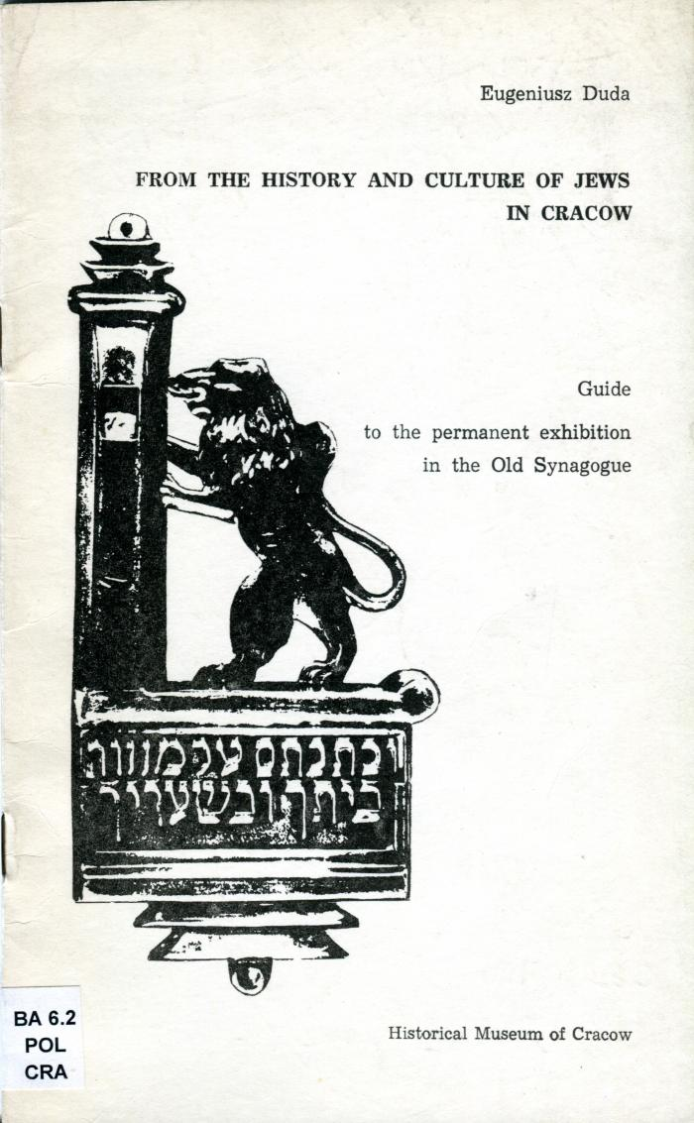
From the history and culture of Jews in Cracow (BI02408)

Slide 497
Froyen-briv (BY03271A)

Slide 498
Froyen-faynt (BY00574A)

Slide 499
Frukhtn vern tsaytik (BY03147A)

Slide 500
Fun ash aroysgerufn... (BY03453B)

Slide 501
Fun berlin biz San-Francisco
Ayndrikn un vizionen (BY00063A)

Slide 502
Funem yarid (BY04039A)

Slide 503
Fun haynt un nekhtn (BY00646A)

Slide 504
Fun Kasrilevke (BY04018A)

Slide 505
Fun krilovs msholim (BY00102A)

Slide 506
Fun mayn lebn (2 bend) (BY02574A)

Slide 507
Fun mayn notits-bukh (BY02573A)

Slide 508
Fun mendelson biz mendele (BY03811B)

Slide 509
Fun mentsh tsu mentsh (BY02638A)

Slide 510
Fun peysakh biz peysakh (BY04019A)

Slide 511
Fun pol tsu pol (BY01366A1)

Slide 512
Fun royten leben (BY02329A)

Slide 513
Fun rusland (BY02881A)

Slide 514
Fun shtot un dorf (BY00342A)

Slide 515
Fun tsvay velten (BY04038A)

Slide 516
Fun unzer alter oytser (zekster band) (BY02019A)

Slide 517
Fun yener zayt (BY02439A)

Slide 518
Gants tevie der milkhiger (BY04022A)

Slide 519
Garber-bund un bershter-bund (BY01578A)

Slide 520
Geklibene lider (BY01998A)

Slide 521
Geklibene lider (BY03957B)

Slide 522
Geklibene shriften (BY01776A)

Slide 523
Geklibene shriften (driter band) (BY00661B)

Slide 524
Geklibene shriften (ershter band) (BY00659B)

Slide 525
Geklibene shriften (ershter band) (BY00663B)

Slide 526
Geklibene shriften (ferter band) (BY00662B)

Slide 527
Geklibene shriften (tsvayter band) (BY00660B)

Slide 528
Geklibene shriftn (BY00397A)

Slide 529
Geklibene shriftn (BY00483B)

Slide 530
Geklibene shriftn (BY01276A)

Slide 531
Geklibene shriftn (BY01506A)

Slide 532
Geklibene verk (band finf) (BY01514A)

Slide 533
Geklibene verk (band III) (BY01505A)

Slide 534
Geklibene verk (ershter band) (BY00685B)

Slide 535
Geklibene verk (tsvay bend) (BY01504A)

Slide 536
General gavriel (BY02098A)

Slide 537
General hershelman (BY00539A)

Slide 538
Gershon in amerike (BY02051A)

Slide 539
Gershon in Amerike (BY03053A)

Slide 540
Geshikhte fun der filizofie (BY03643A)

Slide 541
Geshikhte fun der mayriv-ayropeisher literatur (BY03616B)

Slide 542
Geshikhte fun der yidisher literatur (1ter band) (BY03641B)

Slide 543
Geshikhte fun materializm (BY02152A)

Slide 544
Geshikhte fun sotsializm (ershter tayl) (BY00697A)

Slide 545
Geshikhte fun sotsializm (ferter tayl) (BY00698A)

Slide 546
Geshikhte fun sotsializm (finfter tayl) (BY00699A)

Slide 547
Geshikhte fun tsionizm (BY01005B)

Slide 548
Geshikhte fun yidn in altertum (BY00315A)

Slide 549
Geshlekht un kharakter (BY01408A)

Slide 550
Geshlekht un kharakter (tsvayter tayl) (BY01437A)

Slide 551
Geshtaltn un perzenlekhkaytn (BY02505A)

Slide 552
Geter zenen durshtik (BY03178A)

Slide 553
Getraye libe (BY02535A)

Slide 554
Getraye libe (BY02746A)

Slide 555
Getraye libe (BY02905A)

Slide 556
Gevezene mentshn (BY00894A)

Slide 557
Geviksn (BY00476B)

Slide 558
Gezamelte shriften (BY00137A)

Slide 559
Gezamelte shriften (BY00671A)

Slide 560
Gezamelte shriften (BY02449A)

Slide 561
Gezamelte shriften (7e volume) (BY00140B)

Slide 562
Gezamelte shriften (draytsenter band)
Pionern (BY00141A)

Slide 563
Gezamelte shriften (driter band)
Komedies (BY00152B)

Slide 564
Gezamelte shriften (elfter band) (BY00151B)

Slide 565
Gezamelte shriften (firter band) (BY00138A)

Slide 566
Gezamelte shriften in fuftsen bender (BY00136A)

Slide 567
Gezamelte shriften in fuftsen bender mit der biografye un bilder fun oytor (ershter band) (BY00143A)

Slide 568
Gezamelte shriften (naynter band) (BY00142A)

Slide 569
Gezamelte shriften (tsenter band - elfter band - naynter band)
Zikhroynes (ershter un tsvayter tayl)
In strom (BY00144A)

Slide 570
Gezamelte shriften (tsvayter band) (BY00139A)

Slide 571
Gezamlte dramen (ershter band) (BY01361B)

Slide 572
Gezamlte shriftn (BY03470A)

Slide 573
Gezamlte shriftn
Albert aynshtayns teorye fun relativitet (tsvelfter band) (BY01716B)

Slide 574
Gezamlte shriftn (driter band) (BY01737A)

Slide 575
Gezamlte shriftn (elfter band) (BY01736B)

Slide 576
Gezangen fun kamf (BY00434A)

Slide 577
Gezang fun doyres (2ter tayl) (BY02276A)

Slide 578
Gezang un deklamatsie (BY03418A)

Slide 579
Gezang Un Shpil (BI08240)

Slide 580
Gezukht un nisht gefunen (BY01417A)

Slide 581
Giza Frankel, Wycinanka w papierze, zydowska sztuka ludowa (BI01659)

Slide 582
Grezeles pasirungen (BY03720A)

Slide 583
Grezeles pasirungen (BY03902A)

Slide 584
Grine shotns (BY03583A)

Slide 585
Groyse mentshn, groyse maysim (BY02042A)

Slide 586
Groyse mentshn, groyse maysim (BY02045A)

Slide 587
Guide de l'Institut Historique Juif (BI03176)

Slide 588

Guide de l'Institut Historique Juif
Varsovie (BI03924)

Slide 589
Gute ziten un shene manieren (BY03618A)

Slide 590
Halo ayrope ! (BY01970A)

Slide 591
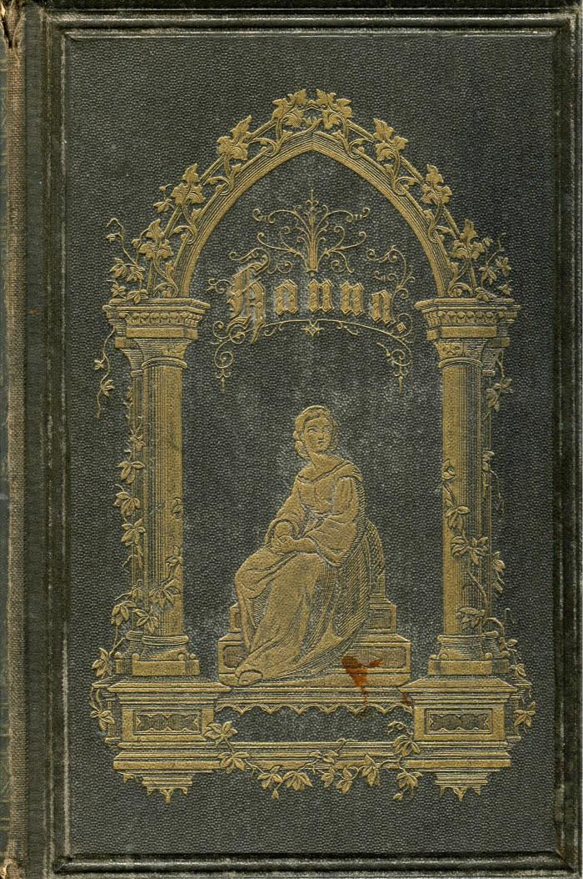
Hanna (BI12132)

Slide 592
Hantbukh far bibliotekn (BY03841A)

Slide 593
Heaven's gates (BI03952)

Slide 594
Hebraisch-Deutsches Wörterbuch (BI07071)

Slide 595
Hebrajskie Inskrypcje (BI01635)

Slide 596
Heldn un martirer (2 bend) (BY03990A)

Slide 597
Hershele (BY01185A)

Slide 598
Heymerd (BY01316A)

Slide 599
Himel un erd (BY00373A)

Slide 600
Hintele shvarts un ketsele vays (ersht bikhl) (BY03651A)

Slide 601
Hintele shvarts un ketsele vays (tsvayt bikhl) (BY03652A)

Slide 602
Hinter a farmakhter tir (BY03282A)

Slide 603
Hirshele (BY03212A)

Slide 604
Hundert protsent (BY02828B)

Slide 605
Huntman (BY00098A1)

Slide 606
Ibergang (BY01621A)

Slide 607
Ideal un elnd (BY03827B)

Slide 608
Idilien un baladen (BY02840A)

Slide 609
Idiot (BY03567A)

Slide 610
Idishe folks-geshikhte (BY01077B)

Slide 611
Idishe folks-geshikhte (band 13 - 16) (BY01081B)

Slide 612
Idishe shrayber (BY04031A)

Slide 613
I-II : Ertselungen
III : yudish teater un yudishe literatur
IV : Shotenbilder
V : Felietonen (BY03304A)

Slide 614
iIn roytn shtrom (BY03430A)

Slide 615
II Tsuzamenfor fun PZPR
Barikht fun tsentral komitet fun PZPR (BY00431A)

Slide 616
Ikh mus dertseyln (BY03765A)

Slide 617
Ikh mus dertseyln (BY03876A)

Slide 618
Ikh vil aheym ! (BY01976A)

Slide 619
Ikh, zi un er (BY02912A)

Slide 620
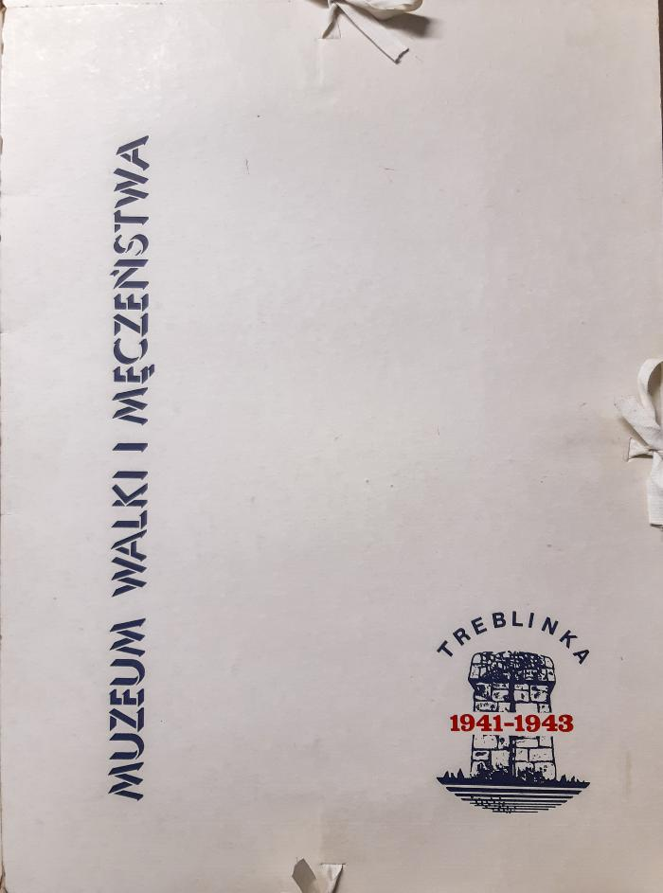
Impresja I (04518)

Slide 621
In a puster shtot (BY00926A)

Slide 622
In bovl (BY03362A)

Slide 623
In di teg fun revolutsie (BY03574A)

Slide 624
In di vayse tsafon-velder (BY02142A)

Slide 625
In di vayse tsafon-velder (BY02143A)

Slide 626
In dorf (BY03484A)

Slide 627
In eliashi's kinigraykh (BY00120A)

Slide 628
In fayer un blut (BY01301A)

Slide 629
Inferno of choices (BI06960)

Slide 630
Ingeborg (BY03649A)

Slide 631
Ingeborg (BY03656A)

Slide 632
In geroysh fun mashinen (BY01689A)

Slide 633
In gutn mut (BY01905A)

Slide 634
In himlishn okean (BY02851A)

Slide 635
In hundert yor arum (BY00692A)

Slide 636
In kamf farn revolutsionern sotsializm (BY02966A)

Slide 637
In land fun der vaysel (BY03155A)

Slide 638
In land fun rasn-diskriminatsie (BY02227A)

Slide 639
In lebn farlibt (BY03605A)

Slide 640
In loyf fun yorn (BY00726A)

Slide 641
In New York (BY01266b)

Slide 642
In new york (BY01679A)

Slide 643
In poylishe velder (BY00270B)

Slide 644
In poylishe velder (BY00271A)

Slide 645
In shotn (BY01613A)

Slide 646
In shotn fun der kirkh (BY03176A)

Slide 647
In shturm (BY02196B)

Slide 648
In shturm (BY04024A)

Slide 649
In the shadow of the Skoczow synagogue (BI01564)

Slide 650
Intruz (BI07008)

Slide 651
In tsvay velten (BY02280B)

Slide 652
In undzer tsayt (BY01317A)

Slide 653
Ishim (BY02783A)

Slide 654
JAN KARSKI (BI08574)

Slide 655

Jüdische Sprichwörter und Redensarten (BI12123)

Slide 656
Jerozolima W Kulturze Europejskiej - (BI05431)

Slide 657
Jerzy Kosinski (BI04916)

Slide 658
Jewish Album (BI04948)

Slide 659
Jewish Cemetery in Lodz (BI01632)

Slide 660
Jewish landmarks in Lodz (BI06612)

Slide 661
Jimmy Higgins (BY02833A)

Slide 662

Jonasz Stern (BI09337)

Slide 663
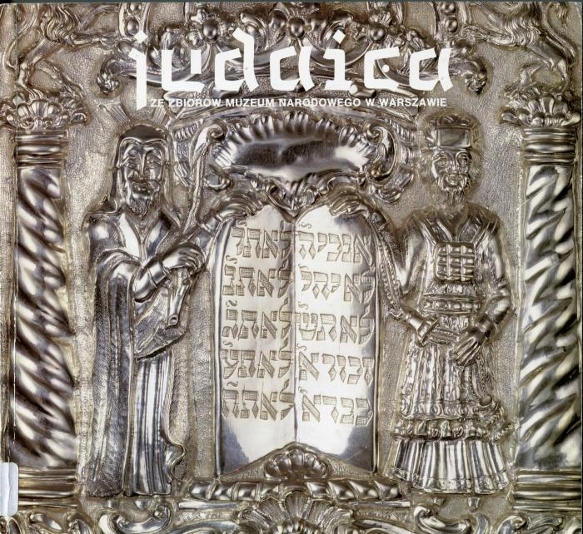
Judaica (BI02411)

Slide 664
Judaika (BI04910)

Slide 665
Kalt un varem (BY01604A)

Slide 666
Kamf (BY00806A)

Slide 667
Kant's etik (BY04073B)

Slide 668
Karl Marks (BY00989A)

Slide 669
Karl Marx (BY01115A)

Slide 670
Karl Marx (BY01116B)

Slide 671
Karl Marx (BY01286A)

Slide 672
Karnaval (BY01651B)

Slide 673
Kazimierz : The Jewish Quarter of Cracow 1870-1988 (BI01556)

Slide 674
Kegnzaytike hashpoes in velt-shafn (BY02509A)

Slide 675
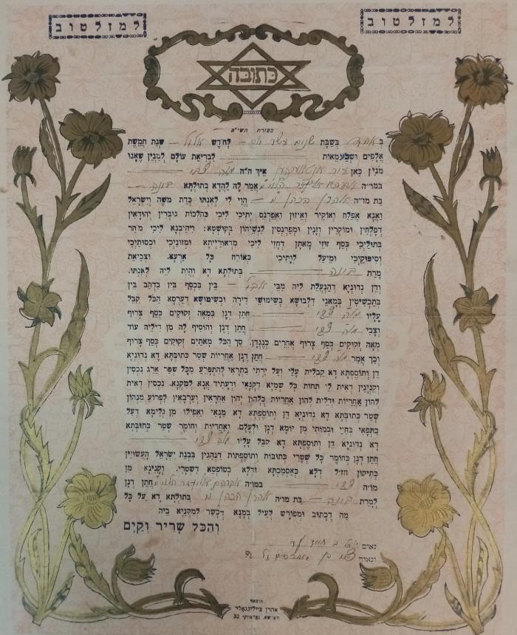
Ketouba de Aaron Ha-Cohen-Tsvi (00475)

Slide 676
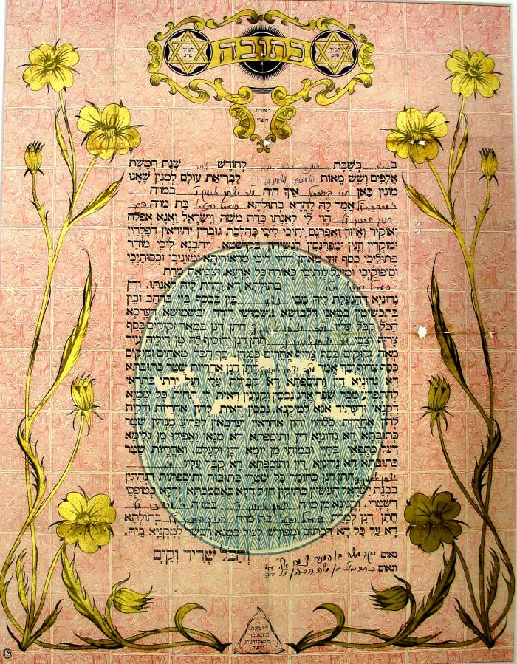
Ketouba Eizig-Yenta (00300)

Slide 677
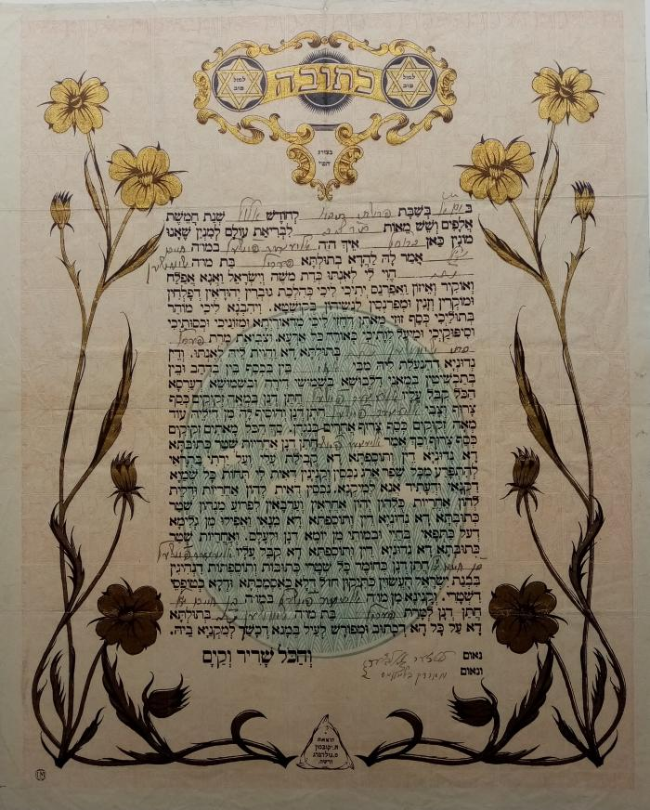
Ketouba Fischel-Pérol (06090)

Slide 678
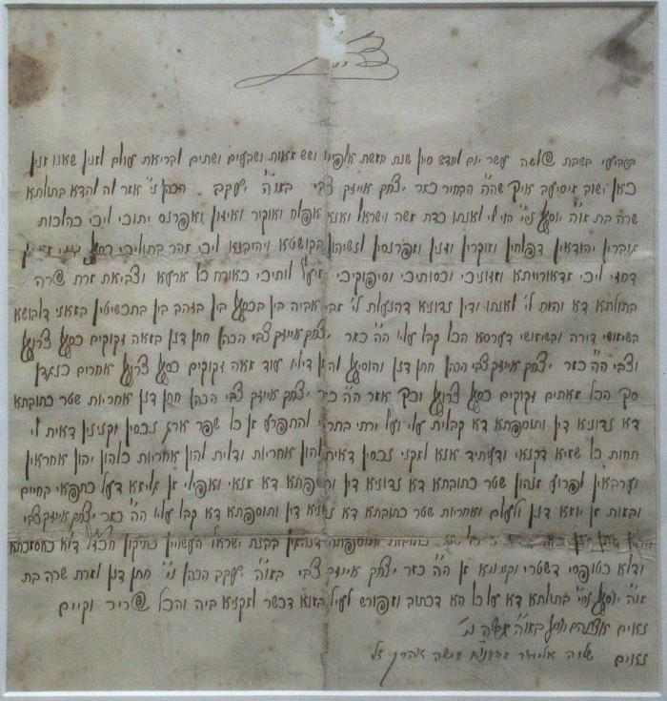
Ketouba Kahan-Pasternak (00479)

Slide 679
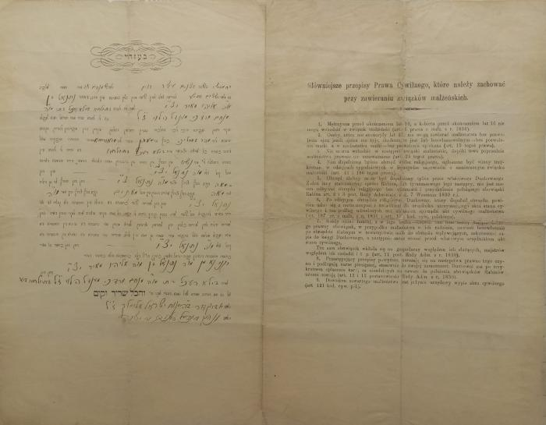
Ketouba Meir-Bela (00471)

Slide 680
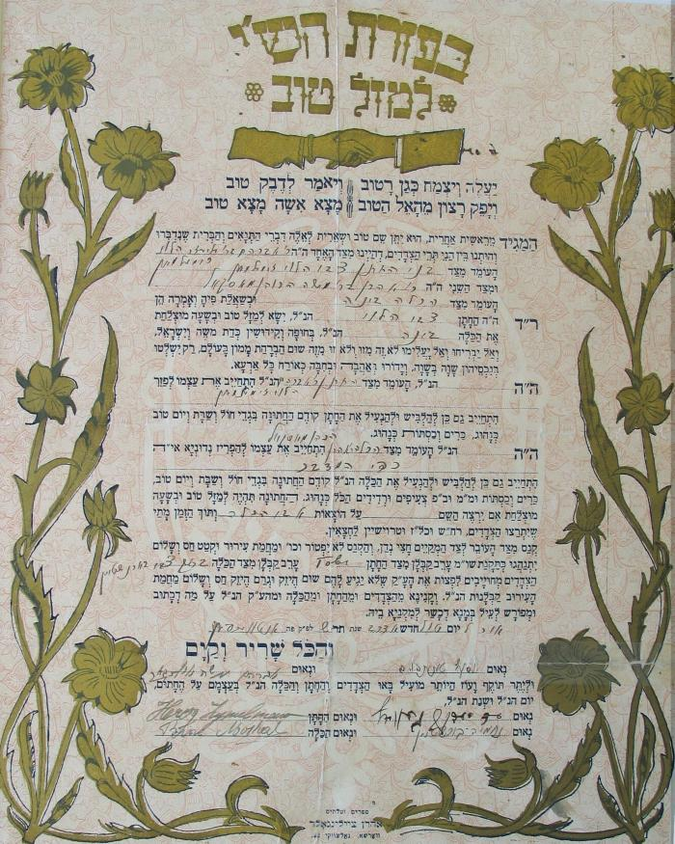
Ketouba Moskal-Zymelman. (00474)

Slide 681
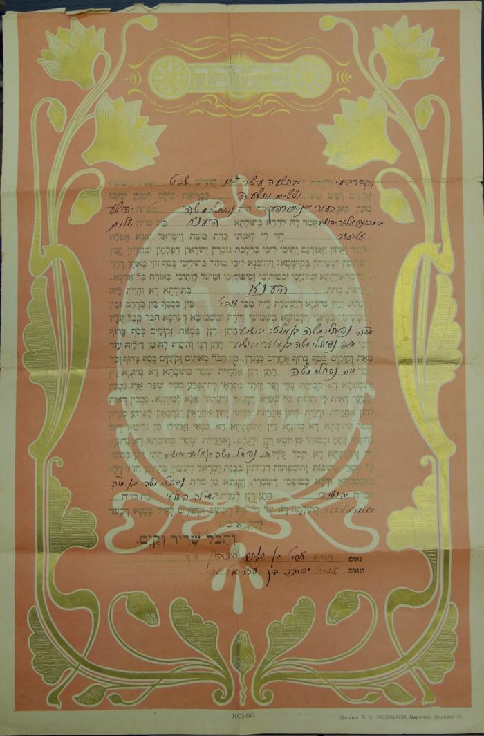
Ketubah / Ketouba (15358)

Slide 682
Khadzhi-mourat (BY01780A)

Slide 683
Khaver Kisliakov (BY03766A)

Slide 684
Khelemer Mayses (BY03551A)

Slide 685
kh'farbren pariz (band 1) (BY02035A)

Slide 686
kh'farbren pariz (tsvay bend) (BY01981A)

Slide 687
Kh'hob faflantst a boym (BY03901A)

Slide 688
Kh. N. Bialik (BY02520A)

Slide 689
Kh'ob farflantst a boym (BY03848A)

Slide 690
Khulio khurenito (BY02971A)

Slide 691
Khurves dertseyln...
Dos bukh fun gvure (BY02400A)

Slide 692
Kidush-hashem (BY00351A)

Slide 693
Kinder (BY00925A)

Slide 694
Kinder-dertsiung (BY02595A)

Slide 695
Kind un rind (BY02263A)

Slide 696
Kira kiralina (BY00115A)

Slide 697
KL AUSCHWITZ (BI08563)

Slide 698
Kleyne menshelekh mit kleyne hashgoyes (BY04023A)

Slide 699
Klorkayt (BY01318A)

Slide 700
Kolekcja (BI03269)

Slide 701
Komedies (BY04037A)

Slide 702
Kontakty chlopsko-zydowskie (BI01658)

Slide 703
Krestomatie (BY03222A)

Slide 704
Ksuvim fun geto (2 bend) (BY03921B)

Slide 705
Kultura Ocalona : Katalog wystawy poswieconej kulturze Zydow polskich (BI02410)

Slide 706
Kultur-geshikhte (ershter tayl) (BY02003B)

Slide 707
Kumendike doyres (BY04066A)

Slide 708
Kunst un gelt (Mammonart) (BY02836A)

Slide 709
Kwiaty Oswiecimia (BI05163)

Slide 710
La dernière étape (05910)

Slide 711

L'affaire du Carmel d'Auschwitz (09215)

Slide 712
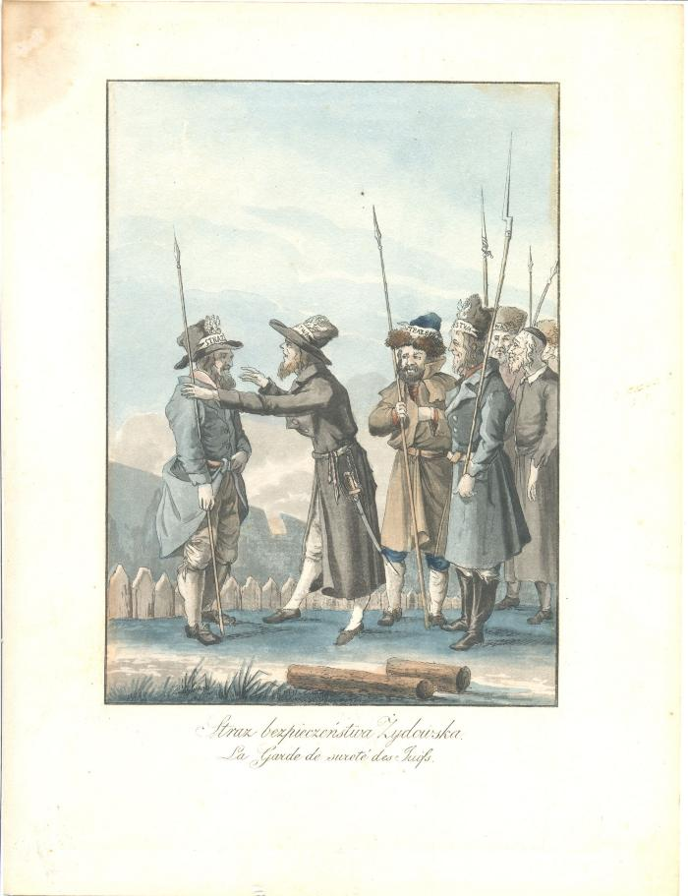
La garde de sûreté des Juifs (10912)

Slide 713
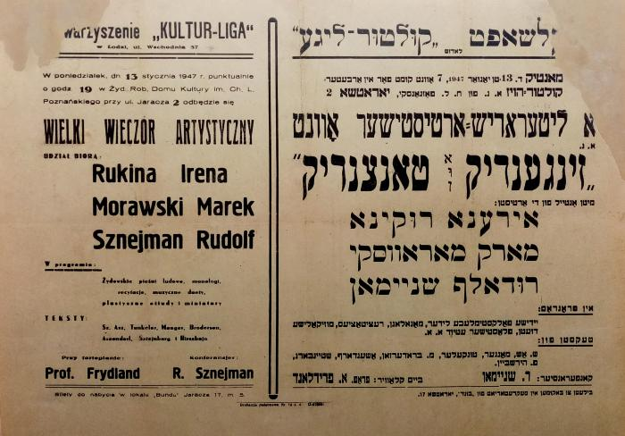
La grande soirée des arts (02208)

Slide 714
Landvirtshaftlekhe kolonizatsye fun di yidn in erets-yisroeyl (BY00731B)

Slide 715
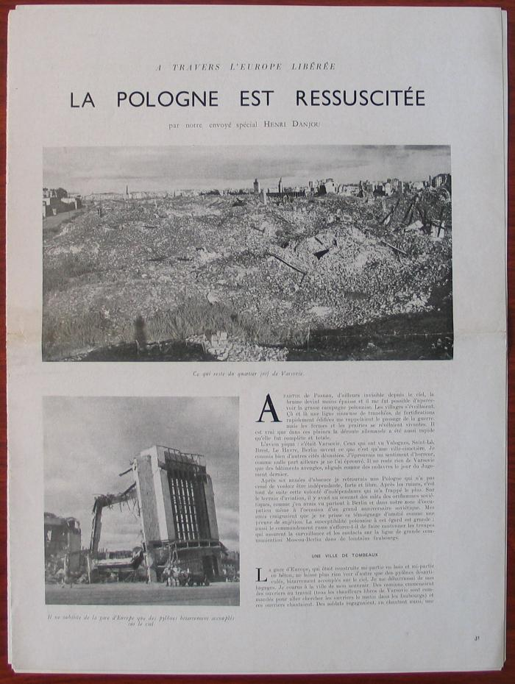
La Pologne ressuscitée (05164)

Slide 716
La Vie de Klim Samgin (Quarante ans)
Vol. I (BY00885A)

Slide 717
Lebn un toyt (BY02698A)

Slide 718
Lebn un toyt (BY02699A)

Slide 719

Le carmel d'Auschwitz / Derniers développements (09212)

Slide 720
Legends of Polish Jews (BI09350)

Slide 721
Le Ghetto de Varsovie (BI09361)

Slide 722
... Lekh-lekho... (BY03964A)

Slide 723
Lekoved yoym-toyv (BY04036A)

Slide 724
Leksikon fun yudishe khokhmes (ershter tayl) (BY01710A)

Slide 725
Lenin (BY03630A)

Slide 726
Lenin (BY03679A)

Slide 727
Leonardo da-vinci (BY01406A)

Slide 728
Leonardo da vintshi (BY02201A)

Slide 729
Leon Lewkowicz - Poprzez Mgle
rzezba, rysunek (BI04933)

Slide 730
Lern-bukh far metal-baarbetung (BY00752B)

Slide 731
Lernbukh fun yidisher geshikhte (BY01956A)

Slide 732
Leshana haba birushalayim ! (BY01810A)

Slide 733

Le temps des pierres (BI01616)

Slide 734
Lev tolstoy (BY03896A)

Slide 735
L'histoire à portes ouvertes (BI06269)

Slide 736
Libe, luksus un kapitalizm (BY02043B)

Slide 737
Lider far kinder (BY02315A)

Slide 738
Lider far kinder (BY02370A)

Slide 739
Lieux du Martyre et du Combat des Juifs en Territoire Polonais en 1939-1945 (BI01367)

Slide 740
Limpopo (BY01875A)

Slide 741
Literatur-bilder (BY00839A)

Slide 742
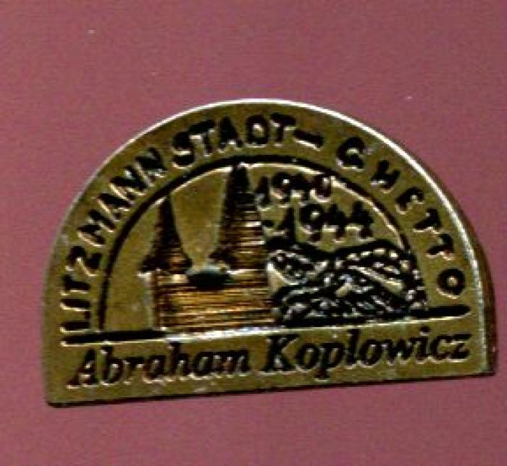
Litzmannstadt-Ghetto (16764)

Slide 743
L. N. Tolstoy in likht fun marksizm (BY01763A)

Slide 744
Lodz (BI02614)

Slide 745
Lodzi (BI07009)

Slide 746
Lulkes (BY02963A)

Slide 747
Lulkes (BY02964A)

Slide 748
Lune Benamor (BY00573A)

Slide 749

Maak geen kruis over mijn verleden. (07211)

Slide 750

Maak geen kruis over mijn verleden
(09184)

Slide 751
Macewy mowia (BI01627)

Slide 752
Madam bovari (BY04003B)

Slide 753
Mademazel zhofr (BY03238A)

Slide 754

Magazyn Filmowy "Powiekszenie"
Rok X (BI08820)

Slide 755
Mahatma gandi (BY03878A1)

Slide 756

Malarstwo i rzezba Zydow Polskich (BI04674)

Slide 757
Malarstwo i rzezba Zydow Polskich (BI07289)

Slide 758
Malines (BY01903A)

Slide 759
Manekiner (BY03050B)

Slide 760
Marks un bakunin (BY00770A)

Slide 761
Marxizm in teorye un praktik (BY01207A)

Slide 762
Mase mentsh (BY01938A)

Slide 763
Mashiakhs tsaytn (BY00354A)

Slide 764
Maskes (BY02732A)

Slide 765
MAURYCY GOTTLIEB (BI08587)

Slide 766
Maurycy Trebacz 1861-1941
Wystawa monograficzna (BI05164)

Slide 767
Mayne kinder-yorn (BY01363A)

Slide 768
Mayne zikhroynes (2ter tayl) (BY03647A)

Slide 769
Mayne zikhroynes funm oyfshtand in varshever geto (BY00877B)

Slide 770
Mayne zikhroynes funm oyfshtand in varshever geto (BY00907A)

Slide 771
Mayn gas iz in fener (BY03825A)

Slide 772
Mayn lebn (BY01942A)

Slide 773
Mayn leyenbukh (BY02167A)

Slide 774
Mayn rayze iber rusland (BY02608A)

Slide 775
Mayn rayze iber rusland (BY02656A)

Slide 776
Mayn rayze in erets yisroeyl (BY01267A1)

Slide 777
Mayselekh (BY03537A)

Slide 778
Mayses fun der rusisher kazarme (BY02870A)

Slide 779
Mayses, vitsn un shpitslekh fun hershel ostropolier (BY00965A)

Slide 780
Mayses, vitsn un shpitslekh fun hershel ostropolier (BY00966A)

Slide 781
Mayses, vitsn un shpitslekh fun Hershl Ostropolier (BY00493A)

Slide 782
Mayses, vitsn un spitslekh (BY00365A)

Slide 783
Maysies far idishe kinder (BY04025A)

Slide 784
Maysies un fantazies (BY04020A)

Slide 785
Mazlen (BY03961A)

Slide 786
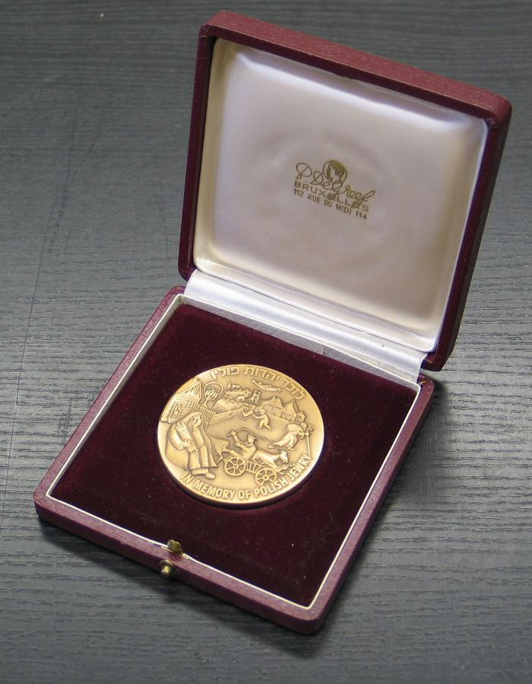
Médaille (00715)

Slide 787
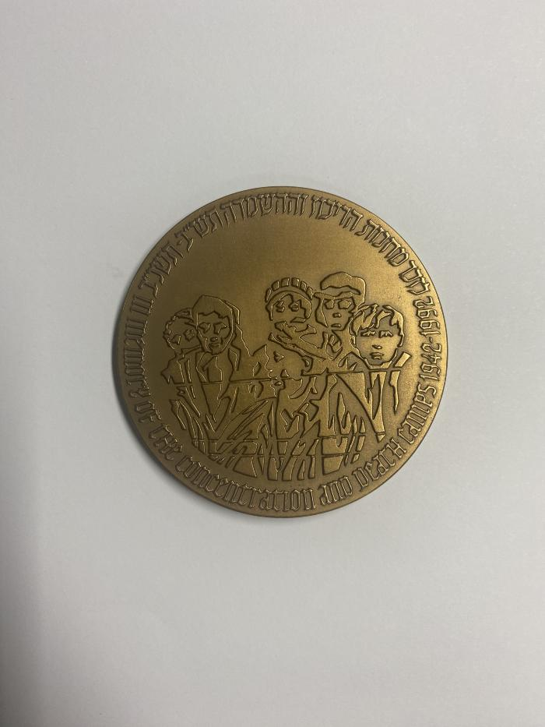
Médaille mémoire des camps (02083)

Slide 788
Meczenstwo i zaglada Zydow (BI06118)

Slide 789
Memoarn fun a bundist (1ter band) (BY03051A)

Slide 790
Memorial Auschwitz Birkenau Miejsce Pamieci (BI06694)

Slide 791
Menakhem-Mendel (BY04026A)

Slide 792
Mendele Moykher-Sforim (BY02549A)

Slide 793
Mentsh-baheyme (BY02348A)

Slide 794
Mentshn in klem
Dertseylungen (BY00092A)

Slide 795
Mentshn un verk
yidishe shrayber (BY02611A)

Slide 796
Mentshn un verk - Yidishe shrayber (BY02659A)

Slide 797
Mentshn un verk
Y. L. Perets (BY02610A)

Slide 798
Mentsh un khaye (BY00594A)

Slide 799
Mentsh un vunder (BY01603A)

Slide 800
Meshikhim (BY03087A)

Slide 801
Meshumodim (BY03340B)

Slide 802
Mette traf (BY02501A)

Slide 803
Miasto Palacow I Jedney Ulicy (BI05214)

Slide 804
Mikh hungert (BY03091A)

Slide 805
Milkhome (2 bend) (BY03890A)

Slide 806
Milkhome-notitsn fun a yidishn ofitsir (tsvay tayl) (BY02587A)

Slide 807
Milkhome un sholem (BY01767A)

Slide 808
Milkhome un sholem (BY01768A)

Slide 809

Mille ans des Juifs en Pologne (BI12167)

Slide 810
Miniaturen un stsenes (8ter band) (BY03918A)

Slide 811
Mirel (BY03154A)

Slide 812
Mit a freylekh ponim (BY02177A)

Slide 813
Mit ash oyfn kop (BY01616A)

Slide 814
Mit di fis aroyf (BY01902B)

Slide 815
Mitn ponim tsu der zun (BY00096A)

Slide 816
Mitn ponim tsum morgn (BY02166A)

Slide 817

Mémoire des camps (00724)

Slide 818
Modele boznic Mosze Werbina (BI01655)

Slide 819
Momentn fun der rusisher revolutsie (BY02869A)

Slide 820
Mon (BY02875A)

Slide 821
Monologen (BY04035A)

Slide 822
Monoteizm... (BI04041)

Slide 823
Montefiore (BY02333A)

Slide 824
Monument de la Révolte du Ghetto à Varsovie (04664)

Slide 825
Moskve (BY00335A)

Slide 826
Motel peysi dem khazn's (2 bend) (BY04033A)

Slide 827
Motywy zydowskie w sztuce polskiej (BI05061)

Slide 828
Moyshe (BY01761A)

Slide 829
Moyshe (BY02550A)

Slide 830
Msholim (BY00099A)

Slide 831
Msholim-bukh (BY00101A)

Slide 832
Msholim-bukh (BY00105A)

Slide 833
MURANOW (BI08579)

Slide 834
Muter un zun (BY00750A)

Slide 835
Napoleon in rusland (BY03775A)

Slide 836
Natsionalizm (BY01788B)

Slide 837
Natur un mentsh (BY01469A)

Slide 838
Natur un mentsh (BY02044A)

Slide 839
Naturvisenshaft - Luft un vaser (1ter tayl) (BY00630A)

Slide 840
Naye dramen (BY00357A)

Slide 841
Naye dramen (BY00358A)

Slide 842
Naye erd (BY00947A)

Slide 843
Naye ertseylungen (BY00352A)

Slide 844
Naye lider (BY01306B)

Slide 845
Naye teg (BY03644A)

Slide 846
Naye verk
I- Ertselungen
II- Lider (BY03804A)

Slide 847
Nay-rusland (BY01655A)

Slide 848

Ne faites pas une croix sur ma mémoire. (08758)

Slide 849
Nerveze mentshn (BY01601A)

Slide 850
Ne'umim
Predigten (BI09157)

Slide 851
Nicht vergessen die Wahrheit bezeugen (BI03339)

Slide 852
Noente un vayte (BY02519B)

Slide 853
Nokhn mabl (BY00641A)

Slide 854

"... nothing belongs to us anymore". (11843)

Slide 855
Novelen (BY00936A)

Slide 856
Novelen fun toyt (BY01740A)

Slide 857
Noveln (BY00361A)

Slide 858
Noveln (BY03101A)

Slide 859
Obraz Zyda w strukturze mitow chlopskich (BI01657)

Slide 860
Oczami Swiadkow (BI03436)

Slide 861
Oliver tvist (BY01192A)

Slide 862
On a loshn (BY03502A)

Slide 863
On a tsil (BY01294A)

Slide 864
ONEG SCHABBAT - DAS UNTERGRUNDARCHIV DES WARSCHAUER GHETTOS (BI08580)

Slide 865
Onkl Mozes (BY00350A)

Slide 866
Opgrunt (BY01827A)

Slide 867
Ophandlungen tsu der geshikhte fun marksizm (BY03842A)

Slide 868
Opkleyb (BY00107A)

Slide 869
Oppidum Judaeorum (BI03951)

Slide 870
Ore di bord (BY03428A)

Slide 871
Oreme un fraylekhe (2 bend) (BY04032A)

Slide 872

Orkiestra i reprezentacyjny chor zydowski. (02207)

Slide 873

"Our only way is work"
The Lodz Ghetto 1940-1944 (BI03890)

Slide 874
Oyf ale teg fun a gants yor (BY00927B)

Slide 875
Oyfbroyz (BY02947A)

Slide 876
Oyf der erd (BY03524B)

Slide 877
Oyf di felder fun treblinke
Reportazh (BY00054B)

Slide 878
Oyf di fligl fun kholem (BY03207A)

Slide 879
Oyf di khurves (BY01090A)

Slide 880
Oyf di shpurn fun gvure (BY01129A)

Slide 881
Oyf di vegn fun baginen (BY03025A)

Slide 882
Oyf di vegn fun der nayer ayropeisher literatur (BY03786A)

Slide 883
Oyf fremde vegn (BY03128A)

Slide 884
Oyf haymisher erd
Lider (BY00027A)

Slide 885
Oyfn bergl (BY03124A)

Slide 886
Oyfn bruk (BY02479A)

Slide 887
Oyf'n grunt fun yam (BY03658A)

Slide 888
Oyfn himl a yarid (BY00563A)

Slide 889
Oyfn mayrev-front nishto kayn nayes (BY03888A)

Slide 890
Oyfn shliakh fun lebn (BY02925B)

Slide 891
Oyfn shvel (BY01911A)

Slide 892
Oyfn taykh (BY03419A)

Slide 893
Oyfn veg tsum mentsh (BY01912A)

Slide 894
Oyfn veg tsum mentsh (BY01920A)

Slide 895
Oyfshtayg (BY00453A)

Slide 896
Oyfshteyg (BY00758A)

Slide 897
Oysgeveylte ertselungen (BY03048A)

Slide 898
Oysgeveylte shriften (ershter band) (BY02644A)

Slide 899
Oysgeveylte verk (2bend) (BY03850A)

Slide 900
Oysgeveylte verk (band II) (BY03246A)

Slide 901
Oysgeveylte verk (band III) (BY03267A)

Slide 902
Oysgeveylte verk (band V, tayl II) (BY03251A)

Slide 903
Oysgeveylte verk (in tsvay bender) (BY03266A)

Slide 904
Palestine-reportazhn (BY02356A)

Slide 905
Paradoxen (BY02619A)

Slide 906
Parizh (BY01575A)

Slide 907
Partsufim (BY03272A)

Slide 908
Pereles hintl (BY03209A)

Slide 909
Perets's bletlikh (1ter band) (BY03255B)

Slide 910
Perpetuated on Film Reels (AR00184)

Slide 911
Pestalotsi (BY03897A)

Slide 912
Peterburg (BY00334A)

Slide 913

photo ancienne famille Icek Szatan, jeux d'échec, Sompolno (Pol.) vers 1925 (p7371)

Slide 914

photo cimetière juif Remuh à Cracovie (p7214)

Slide 915

photo cimetière juif Remuh à Cracovie (p7215)

Slide 916

photo cimetière juif Remuh à Cracovie (p7216)

Slide 917

photocimetière juif Remuh à Cracovie (p7217)

Slide 918

photo cimetière juif Remuh à Cracovie (p7218)

Slide 919

photo cimetière juif Remuh à Cracovie (p7219)

Slide 920

photo cimetière juif Remuh à Cracovie (p7220)

Slide 921

photo cimetière juif Remuh Cracovie, Pologne. (p7108)

Slide 922

photo cimetière juif Remuh Cracovie, Pologne. (p7109)

Slide 923

photo cimetière juif Remuh Cracovie, Pologne. (p7110)

Slide 924

photo cimetière juif Remuh Cracovie, Pologne. (p7111)

Slide 925

photo cimetière juif Remuh Cracovie, Pologne. (p7112)

Slide 926

photo cimetière juif Remuh, Cracovie, Pologne, (p7113)

Slide 927

photo cimetière juif Remuh, Cracovie, Pologne, (p7114)

Slide 928

photo cimetière Remuh Cracovie (p7115)

Slide 929

photo cimetière Remuh Cracovie (p7116)

Slide 930

photo cimetière Remuh Cracovie (p7117)

Slide 931

photo cimetière Remuh Cracovie (p7118)

Slide 932

photo cimetière Remuh Cracovie (p7119)

Slide 933

photo cimetière Remuh Cracovie (p7120)

Slide 934

photo cimetière Remuh Cracovie (p7121)

Slide 935

photo cimetière Remuh Cracovie (p7122)

Slide 936

photo cimetière Remuh Cracovie (p7123)

Slide 937

photo cimetière Remuh Cracovie . (p7124)

Slide 938

photo cimetière Remuh Cracovie (p7125)

Slide 939

photo cimetière Remuh Cracovie (p7126)

Slide 940

photo cimetière Remuh Cracovie (p7128)

Slide 941

photo cimetière Remuh Cracovie (p7129)

Slide 942

photo cimetière Remuh Cracovie (p7130)

Slide 943

photo cimetière Remuh Cracovie (p7131)

Slide 944

photo cimetière Remuh Cracovie par Sucheky. Série de rangées de stèles funéraires entourant l'extension latérale arrière de la synagogue Remuh. (p7127)

Slide 945

photo communité juive, shtetl pologne, première moitié 20 ème siècle, Sompolno? (p7435)

Slide 946

photo couleur tombes sarcophages du cimetière juif Remuh à Cracovie (p7221)

Slide 947

photo de G. Schnek,et représentants gouvernement belge, discours, Auschwitz, mai 2006 (p7314)

Slide 948

photo famille Icek Szatan, célébration Shabbat Sompolno (Pol.) années 1920 (p7373)

Slide 949

photo famille ou amis, Icek Szatan Sopolno (Pol.) 4 mars 1925 (p7370)

Slide 950

photo Flahaut, Onkelinks et G. Schnek, discours, voyage Auschwitz, 7/05/2006 (p7315)

Slide 951

photo Georges schnek, panneau 20ème convoi, Auschwitz 7/05/ 2006 (p7312)

Slide 952

Photographies Don Pawlowicki (p005234)

Slide 953

photo G. Schnek et Germaine Fischler voyage à Auschwitz 7 mai 2006 (p7313)

Slide 954

photo portrait Icek Szatan, souriant (p7372)

Slide 955
Pier un Lutsie (BY03821B)

Slide 956
Pitom un ramses (BY02151A)

Slide 957
Pitom un ramses (BY02181A)

Slide 958

Planète Auschwitz (02581)

Slide 959

"Planète Auschwitz" (03846)

Slide 960

Planète Auschwitz 2 morts (02584)

Slide 961

"Planète Auschwitz. Eli,Eli, lamma azavtanou" (03843)

Slide 962

Planète Auschwitz. Fosse commune (02571)

Slide 963

Planète Auschwitz. Holocaust (02577)

Slide 964

Planète Auschwitz. La faim (02569)

Slide 965

Planète Auschwitz. La marche de la mort (02574)

Slide 966

"Planète Auschwitz. La marche de la mort , où "Diminuendo" (03844)

Slide 967

"Planète Auschwitz. L'enterrement" (03845)

Slide 968

Planète Auschwitz. L'enterrement (bois) (02578)

Slide 969

Planète Auschwitz. L'entr'aide (02570)

Slide 970

Planète Auschwitz. Les 3 pendus (02585)

Slide 971

Planète Auschwitz. Le trésor (la soupe) (02573)

Slide 972

"Planète Auschwitz. Le trésor (la soupe)" (03854)

Slide 973

Planète Auschwitz. L'homme aux yeux de verre (02580)

Slide 974

Planète Auschwitz. Libération (02599)

Slide 975

Planète Auschwitz. Morts et vivants (02579)

Slide 976

Planète Auschwitz. Suicides au fil électrique (02572)

Slide 977

Planète Auschwitz. Tu ne tueras point (02582)

Slide 978
Poemen (BY02911A)

Slide 979
Poezie (BY02475B)

Slide 980
Poezye (BY00558A)

Slide 981
Polacy-Zydzi
Polen-Juden
Poles-Jews
1939-1945 (BI04048)

Slide 982
Poland and the Jews (BI08799)

Slide 983
Pole, Jew, artist
Polah, zyo, artysta (BI06236)

Slide 984
Polichromia nagrobkow na cmentarzach zydowskich w Polsce poludniowo-wschodniej (BI01653)

Slide 985
Polichromia polskich boznic drewnianych (BI01654)

Slide 986
Polin (BI09243)

Slide 987
Polish Jewry - History and Culture (BI06102)

Slide 988
Polish jews in KL Auschwitz :
Name lists (BI03929)

Slide 989
Politishe ekonomye (BY00452A)

Slide 990
Politishe ekonomye (BY01644A)

Slide 991
Politishe ekonomye (BY01983A)

Slide 992
Polska Sztuka Ludowa Rok XLIII-1989 NR 1-2 (BI01649)

Slide 993
Polski Slownik judaistyczny (BI03926)

Slide 994
Polski Slownik judaistyczny (BI03927)

Slide 995
Pompadur (BY02182A)

Slide 996

Portraits Kalman-Korn (16734)

Slide 997
Portretn un problemen (BY00694A)

Slide 998
Portretn un problemen (BY00754A)

Slide 999
Poyern (BY03813A)

Slide 1000
Poyern (BY03815B)

Slide 1001
Poylishe yorn (BY03441A)

Slide 1002
Praktishe arbet oyf natur limud (BY00858A)

Slide 1003
Praktishe arbet oyf natur limud (BY00859A)

Slide 1004

Predigten (BI06760)

Slide 1005
Present in our midst (BI02407)

Slide 1006
Professor shvartsshteyn (BY01596A)

Slide 1007
Przyklady epitafiow hebrajskich na cmentarzach zydowskich w Polsce (BI01652)

Slide 1008
Quo Vadis (2 bend) (BY04010A)

Slide 1009
Rambam in yiddish (BY03489B)

Slide 1010
Rasa (BY00380A)

Slide 1011
Ratnfarband 1936 (BY03988A)

Slide 1012
Rav, Rabbi, Rebbe (BI08140)

Slide 1013
Reb Elkhonon (BY00498A)

Slide 1014
Redes fun a buntar (BY03680A)

Slide 1015
Rekhenbukh (BY03619B)

Slide 1016
Reportazhn fun varshever geto (BY00237A)

Slide 1017
Representations of Auschwitz (BI03513)

Slide 1018
Ringelblum-Archiv - Oneg Schabbat (BI03443)

Slide 1019
Robinzon (BY03814A)

Slide 1020
Robinzon kruzo (BY01201A)

Slide 1021
Robinzon kruzo (BY01230A)

Slide 1022
Romain Rolland (BY03329A)

Slide 1023
Roman fun a ferd-ganef (BY00256B)

Slide 1024
Romantishe yorn (BY02885B)

Slide 1025
Roye erd (BY03725A)

Slide 1026
Royte shtraln (BY01784A)

Slide 1027
Ruinen in zun (BY02344A)

Slide 1028
Sakhalin un katorge (BY01145A)

Slide 1029
Salammbô (BY03191B)

Slide 1030
Salvaged from the Warsaw Ghetto (BI03442)

Slide 1031

SANG OF THE LODZ GHETTO (BI08573)

Slide 1032
Sarah Abramson (BY01923A)

Slide 1033
Saym-redes (BY01003B)

Slide 1034
's brent
1939 - 1942 (BY01036A)

Slide 1035
Sentimentn (BY02916A)

Slide 1036
Shayd-vegn (BY02909A)

Slide 1037
Sheydim (2 bender) (BY01141A)

Slide 1038
Shloyme R' Khayim's (BY02666A)

Slide 1039
Shmate-kloyber (BY02476A)

Slide 1040
Shmate-kloyber (BY02478A)

Slide 1041
Shmuel Hirshenberg (BY02773A)

Slide 1042
Shmuel lehman (BY02296A)

Slide 1043
Shmuglers (BY01416A)

Slide 1044
Shmuglers (BY01477A)

Slide 1045
Sholem-Aleykhem (BY01964A)

Slide 1046
Sholem-Aleykhem (BY03094A)

Slide 1047
Sholem Ash - Ale verk
Dertseylungen un bilder (BY00333A)

Slide 1048
Sholem Ash - Ale verk
Der veg tsu zikh
Onkl Mozes (BY00330A)

Slide 1049
Sholem Ash - Ale verk
Erets Yisroeyl - Meri (BY00329B)

Slide 1050
Sholem Ash - Ale verk
Motke ganev
Di kishef-makherin fun kastilien
Kidush hashem (BY00331A)

Slide 1051
Sholem Ash - Ale verk
Shriften (BY00332A)

Slide 1052
Sholem-Yaakoyv Abramovitsh (BY03294A)

Slide 1053
Shpetzumer (BY01787A)

Slide 1054
Shpil un farvaylung (BY00938A)

Slide 1055
Shpil un lebn (BY01227A)

Slide 1056
Shpil un lebn (BY02183A)

Slide 1057
Shpinoza un bergson (BY02651A)

Slide 1058
Shrayber in kamf far sholem (BY04060A)

Slide 1059
Shrayber un bikher (BY02878A)

Slide 1060
Shriften (BY02960A)

Slide 1061
Shriften (BY03492A)

Slide 1062
Shriften (BY03690B)

Slide 1063
Shriften (1-ter band) (BY01834A)

Slide 1064
Shriften (1-tes bukh) (BY03368A)

Slide 1065
Shriften (4-ter band) (BY01833A)

Slide 1066
Shriften (band III) (BY03307B)

Slide 1067
Shriften (driter band) (BY03808A)

Slide 1068
Shriften fun Avrohom Reyzen (band I) (BY03805A)

Slide 1069
Shriften fun Avrohom Reyzen (band I) (BY03806A)

Slide 1070
Shriften (tsvayter band) (BY03807A)

Slide 1071
Shriften (tsvayter band) (BY03809B)

Slide 1072
Shriftn (BY00824B)

Slide 1073
Shtadlonim (BY03342B)

Slide 1074
Shtegn-vegn (BY02871A)

Slide 1075
Shvartse feld (BY01238A)

Slide 1076
Shvarts-royt (BY00171A)

Slide 1077
Shvarts un vays (BY03216A)

Slide 1078
Shvarts un vays (BY03217A)

Slide 1079

Shylock et Jessica (12816)

Slide 1080
Simon Mondzain (BI04969)

Slide 1081
SIMON MONDZAIN (BI08583)

Slide 1082

Slownik (BI11932)

Slide 1083

Slownik francusko-polski i posko-francuski (BI11903)

Slide 1084
Sore Shayndel (BY02129A)

Slide 1085
Sotsiale role fun khemie (BY00147A)

Slide 1086
Sotsiale role fun khemie (BY00153A)

Slide 1087
Sotsialistishe etiudn un poliltishe skitsn (BY02502A)

Slide 1088
Sotsiologishe etiudn un politishe skitsn (BY02563A)

Slide 1089
Sotsiologishe etiudn un politishe skitsn (BY02564B)

Slide 1090
Sovietishe dramaturgie (BY01819A)

Slide 1091
Soydes (BY02922B)

Slide 1092
Soydes (ershter tayl) (BY04004B)

Slide 1093
Spetsiele un algemayne relativitets-teorie (BY00917A)

Slide 1094
Spinoza un zayn svive (BY03980A)

Slide 1095
Stam (BY02431A)

Slide 1096

Stara Boznica Kazimierska (BI02409)

Slide 1097
Stary Zydowski Cmentarz w Krakowie (BI01636)

Slide 1098
Stories from Oswiecim (BI09085)

Slide 1099
Strunes (BY02882A)

Slide 1100
Symbole I Obrazy (BI02560)

Slide 1101
Symbolika plaskorzezb na cmentarzach zydowskich w Polsce (BI01651)

Slide 1102
Synagogues and Jewish Communities in The Bialystok Region (BI01479)

Slide 1103

Szajna 70 lat (BI05152)

Slide 1104
Szkice z dziejow gminy Zydowskiej oraz cmentarza w Lodzi (BI01631)

Slide 1105
Tais (BY03183A)

Slide 1106

Tams Reise durch die jüdische Märchenwelt (BI11979)

Slide 1107
Tanakh visnshaft (BY03547B)

Slide 1108
Tankred (BY01160A)

Slide 1109
Taïs (BY02943B)

Slide 1110
Tashkent (BY02713A)

Slide 1111
Teater un drame (ershter band) (BY01498B)

Slide 1112
Teater un drame (ershter band) (BY01499A)

Slide 1113
Teater un drame (in tsvay bend) (BY01496A)

Slide 1114
Teatralya (BY01934B)

Slide 1115

Teatr Zydowski W Polsce do 1939 (BI05339)

Slide 1116
Teorie fun historishn materializm (ershter tayl) (BY02303A)

Slide 1117
Teorye fun historishn materializm (BY00526A)

Slide 1118
Teorye fun historishn materializm (ershter band) (BY00543A)

Slide 1119
Teorye fun historishn materializm (Tayl IV-V) (BY00542A)

Slide 1120
Teorye fun historishn materializm (tsvayter band) (BY00544A)

Slide 1121
The Amsterdam of Polish Jews (BI08999)

Slide 1122

The fate of the Lubomirski Dürers (BI03195)

Slide 1123
The Jewish Cemetery in Lodz (BI01634)

Slide 1124
The Jewish Cemetery Tomaszow-Mazowiecki : Zydowski Cmentarz (BI01617)

Slide 1125
The Jewish Historical Institute in Poland (AR00222)

Slide 1126
The Jews of Poznan (BI09100)

Slide 1127

The Museum of the Jewish Historical Institute (BI02378)

Slide 1128
The Old Jewish Cemetery in Lublin (BI01626)

Slide 1129

The open-ended past (BI03046)

Slide 1130
The power of persuasion (BI05398)

Slide 1131
The Ringelblum Archive (BI08648)

Slide 1132
The Warsaw ghetto (BI06116)

Slide 1133
Those who helped (BI03344)

Slide 1134
Those who helped (BI03345)

Slide 1135
Tiren - fenster (BY03438A)

Slide 1136
Tolstoy (BY03819B)

Slide 1137

Tombe de Samuel Eliasberg (00490)

Slide 1138
Toyt-urtayl (BY00356A)

Slide 1139
Toyt-urtayl (BY00359A)

Slide 1140

Treasures of the Galician Jewish Heritage
Skarby dziedzictwa galicyjskich zydow (BI03925)

Slide 1141
Treytl (di geshikhte fun a shtetl) (BY02926B)

Slide 1142
Troymland (BY03584B)

Slide 1143
Tsigayner (BY03138A)

Slide 1144
Tsu a nay lebn (BY02972A)

Slide 1145
Tsu mayn nayer haym (BY02908A)

Slide 1146
Tsum bayshpil pleve (BY01677A)

Slide 1147
Tsvay veltn (BY00347A)

Slide 1148
Tsvay veltn (BY00374A)

Slide 1149
Tsvishn falendike vent (BY00454A)

Slide 1150
Tsvishn fremde mentshn (BY00903A)

Slide 1151
Ukraine vaynt (BY03993A)

Slide 1152
Umgekumene yidishe kinstler (2 bend) (BY02883A)

Slide 1153
Undzer rekhnbukh (BY02580B)

Slide 1154
Undzer Sholem-Aleykhem (BY02527A)

Slide 1155
Unter der brik (BY03112A)

Slide 1156
Unter der brik (BY03123A)

Slide 1157
Unter der fon fun K.P.P. (BY00232B)

Slide 1158
Unter der zun (BY03153A)

Slide 1159
Unter der zun fun afrike (tsvay bend) (BY01584A)

Slide 1160
Unter di fligel fun toyt (BY01611A)

Slide 1161
Uriel Akosta (BY02309A)

Slide 1162

Uroczysta Akademia (02230)

Slide 1163
Uroddzony w Turku (BI04813)

Slide 1164
Vampir (2 bend) (BY02989A)

Slide 1165
Varshe (BY00376A)

Slide 1166
Varshe - dos vigele fun yidishn teater (BY01058A)

Slide 1167
Varshe - dos vigele fun yidishn teater (BY01816A)

Slide 1168
Varshever almanakh (BY00415A)

Slide 1169
Varshever purim-shpiler (BY01815A)

Slide 1170

Varsovie 1943: à ma mère (01870)

Slide 1171
Vayb un man (BY03732B)

Slide 1172
Vayse frimorgns (BY03563A)

Slide 1173
Vayse nekht
Eybiker man (BY01142B)

Slide 1174
Vayt fun moskve (BY00015A)

Slide 1175
Vegn altyidishn roman un novele (BY02957B)

Slide 1176
Vegn der seksueler frage (BY01782A)

Slide 1177
Vegn klaynem elfant (BY03538A)

Slide 1178
Vegn yidishe shrayber (BY02631A)

Slide 1179
Vegvayzer far dramatishe krayzn (BY01883A)

Slide 1180
Velt-geshikhte (BY00004A)

Slide 1181
Velt-geshikhte band VIII (ershter tayl) (BY02000B)

Slide 1182
Velt-geshikhte (firter tayl) (BY02996B)

Slide 1183
Ven der friling kumt
Lider (BY00062A)

Slide 1184
Ven ikh vel vider zayn klayn (BY03507A)

Slide 1185
Ver iz shuldig inm velt-krig (BY03539A)

Slide 1186
Vi alt iz di erd ? (BY02146A)

Slide 1187
Vi azoy ikh hob gefunen livingston (BY02849A)

Slide 1188
Vi azoy i!kh hob ibergelebt di daytshn (BY03907B)

Slide 1189
Viazoy tsu dertsien kinder on kantshik (BY00509A)

Slide 1190
[VIDE] (04662)

Slide 1191

[VIDE] (08992)

Slide 1192
[VIDE] (BY00097A)

Slide 1193
Viderklangen un vidershprukhn (BY03501B)

Slide 1194
Viktor hugo (BY02412A)

Slide 1195
Viktoria (BY01407A1)

Slide 1196
Vilyenke un maye (BY02397A)

Slide 1197
Vinsh-fingeril (BY00419)

Slide 1198
Vinsh-fingeril (2 bend) (BY02664A)

Slide 1199
Virklikhkayt (BY01509A)

Slide 1200
Vi shpet iz ?
Shmusn vegn tsayt (BY00067A)

Slide 1201
Vivat, Lebn !... (BY03327A)

Slide 1202
Voglenish (BY02438A)

Slide 1203
Vos kumt for in daytshland ? (BY01646A)

Slide 1204
Vu di oygn trogn (BY00418A)

Slide 1205
Vu di oygn trogn (BY01489A)

Slide 1206
Warszawa Judaica (BI06613)

Slide 1207
Warszawa na fotografiach (BI08526)

Slide 1208
Warszawskie Getto (BI03441)

Slide 1209
W Cieniu Skoczowskiej Synagogi (BI01565)

Slide 1210

Wieczor Chanukowy (02232)

Slide 1211
Wroclawscy Zydzi 1850-1944 (BI01555)

Slide 1212
W Stulecie Cmentarza Zydowskiego W Lodzi :
1892-1992 (BI01670)

Slide 1213

Wystawa dziel artystow zydowskich 1918-1939 (BI04676)

Slide 1214

Żydowski handlarz starzyzny (02224)

Slide 1215
Yermiohu (BY03332A)

Slide 1216
Yeshu hanotsri (BY00480A)

Slide 1217
Yeshu hanotsri (BY00481A)

Slide 1218
Yeshu hanotsri (BY00482A)

Slide 1219
Yesudes fun radio (BY02357A)

Slide 1220
Yesudes fun radio (BY02546A)

Slide 1221
Yeyshu hanotsri (BY02083A)

Slide 1222
Yiddish (BY02876B)

Slide 1223
Yidishe geshikhte (band I,II ; IV-VII) (BY01082B)

Slide 1224
Yidishe kultur-fragn un der sotsializm (BY01958A)

Slide 1225
Yidishe motivn in der poylisher kunst (BY02772A)

Slide 1226
Yidisher kolonist (BY02924B)

Slide 1227
Yidisher kolonist (BY04061B)

Slide 1228
Yidishe shprakh (BY03221A)

Slide 1229
Yidishe shrayber in der heym (BY03439A)

Slide 1230
Yidishe tipn in der poylisher literatur (BY01532A)

Slide 1231
Yidish teater in poyln (BY01818A)

Slide 1232
Yidn in mitlalter (BY00038A)

Slide 1233
Yidn in mizrekh-ayrope fun di eltste tsaytn biz der mongolisher invazye (1240) (BY02618A)

Slide 1234
Yidn in shpanishn krig 1939 - 1936 (BY01157A)

Slide 1235
Yidn in shpanishn krig 1939 - 1936 (BY01158A)

Slide 1236
Yidn on gele lates (BY02816A)

Slide 1237
Yidn on gele lates (BY02817A)

Slide 1238
Yokhid, mase, firer (BY02443A)

Slide 1239
Yorn fargangene, yorn umfargeslekhe (BY00830A)

Slide 1240
Yosele solovey (BY04030A)

Slide 1241
Yoyseyf Opatoshu (BY02521A)

Slide 1242
Yozef Pilsudski (BY03932A)

Slide 1243
Yudishe geshikhte loyt der toyre (BY01985A)

Slide 1244
Yudishe geshikhte (ziben bender) (BY01060A)

Slide 1245
Yudishe ketovim (BY00180A)

Slide 1246
Yudishe ksovim (tsvayter tayl) (BY01756B)

Slide 1247
Yudisher sintaksis (BY01386B)

Slide 1248
Yudisher sintaksis (BY01436A)

Slide 1249
Yudishe zamelbikher (BY00399A)

Slide 1250
Yudishe zamelbikher (BY01511B)

Slide 1251
Yudishe zamelbikher (BY01512B)

Slide 1252
Yugend-romanen (BY04034A)

Slide 1253
Yugend-velten (BY02199A)

Slide 1254
Yugnt-psikhologie un sotsialistishe dertsiung (BY03556A)

Slide 1255
Yulian tuvim far kinder (BY00110B)

Slide 1256
Yunge gazlonim (BY01896A)

Slide 1257
Yunge gazlonim (BY01897A)

Slide 1258
Yunge meydlekh (BY04001A)

Slide 1259
Zachowane synagogi i domy Modlitwy w Polsce Katalog (BI01485)

Slide 1260
Zadania zydow na emigracji w walce o niepodleglosc polski (BI00792)

Slide 1261
Zamlbukh (BY00364A)

Slide 1262
Zavl Rimer (BY02569A)

Slide 1263
Zavl Rimer (BY02570B)

Slide 1264
Zayn gelibte un ikh (BY03243A)

Slide 1265
Zayt gezunt (BY00804A)

Slide 1266
Zeit der Steine (BI01606)

Slide 1267
Zherminal (BY01574B)

Slide 1268
Zhitlovski-zamlbukh (BY01733B)

Slide 1269
Zhitlovski-zamlbukh (BY01734A)

Slide 1270
Zhokasta (BY03182A)

Slide 1271
Zibn in bunker (BY00873A)

Slide 1272
Zibn in bunker (BY00874A)

Slide 1273
Zikhroynes fun a botvinist (BY01486A)

Slide 1274
Zikhroynes fun a terrorist (BY02767A)

Slide 1275
Zikhroynes fun a yidishn sotsialist (2 bend) (BY02503A)

Slide 1276
Zikhroynes fun a yudisher sotsialist (BY02566A)

Slide 1277
Zikhroynes fun a yudishn sotsialist (2 bend) (BY02504A)

Slide 1278
Zikhroynes fun toytn hoyz (2 tayln) (BY01180A1)

Slide 1279
Zikhroynes un iberlebenishn (BY00464B)

Slide 1280
Zikhroynes un iberlebenishn (BY00467A)

Slide 1281

Zikhroynes vegn Mendelen (BY00420)

Slide 1282
Zikhroynes vegn Mendelen (BY02667A)

Slide 1283
Zogt di velt a moshl (BY00103A)

Slide 1284
Zoologie (ershter tayl) (BY02002B)

Slide 1285
Zumer-leben (BY04028A)

Slide 1286
Zunike teg (BY01591A)

Slide 1287

Zydowscy Artysci plastycy ofiary hitlerowskiej okupacji w Polsce (BI05060)

Slide 1288
Zydowskim szlakiem po Tarnowie (BI02819)

Slide 1289

Zydzi - Polscy (BI04675)

Slide 1290

Zydzi w Polsce (BI04673)

Slide 1291
Zydzj w kjelcack
Jews in Kielce
Die Juden in Kjelce (BI01562)

