Slide 1
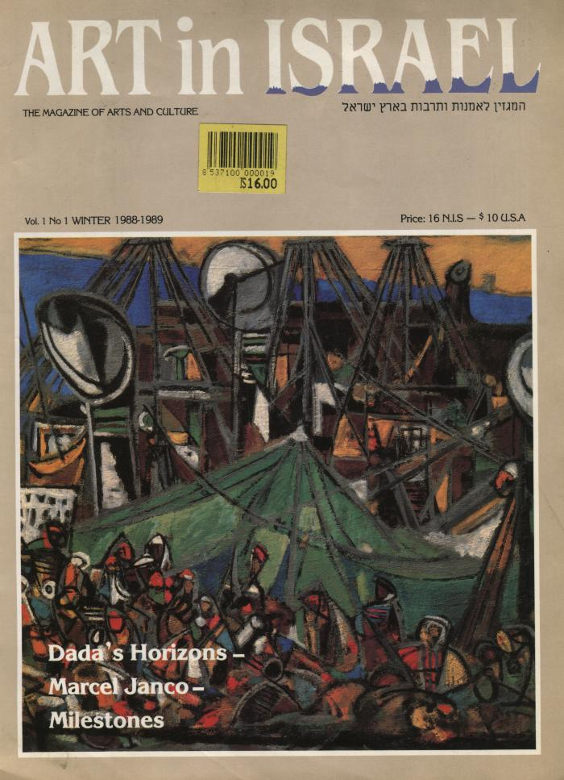
Art in Israel (BI11869)

